Slide 1
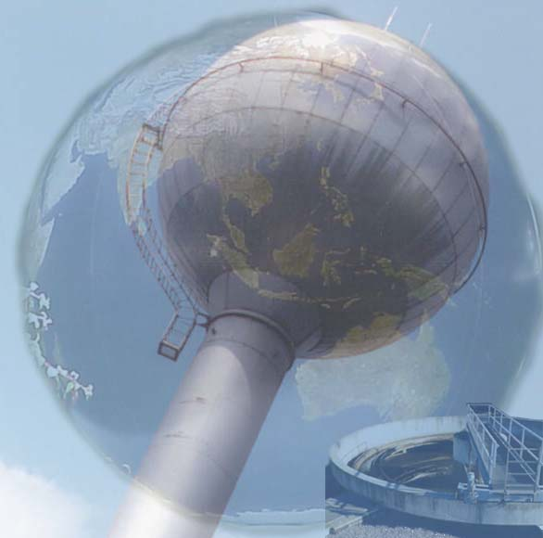
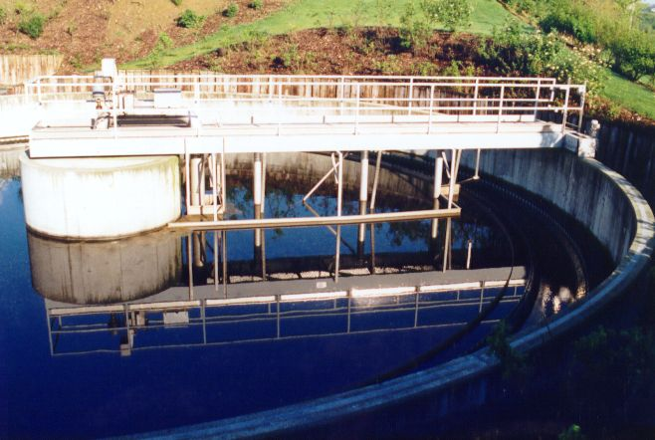
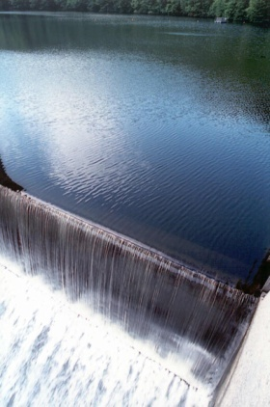
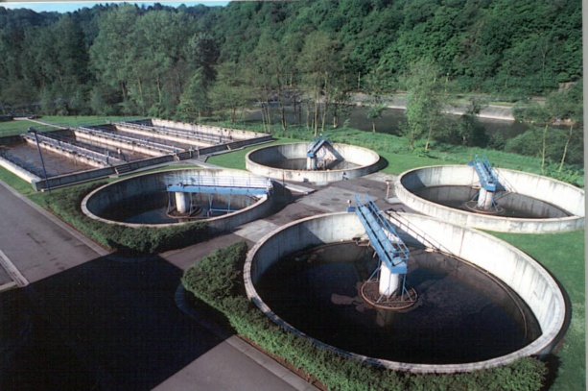


FUNDING OF THE WASTE WATER TREATMENT SECTOR
IN WALLONIA
ESTONIAN WATER WORKS
ASSOCIATION EVEL
STUDY TOUR IN WALLONIA (BELGIUM)
26th October 2015 - Namur

Slide 2
SPGE IN THE CONTEXT OF THE WALLOON WATER SECTOR

Slide 3


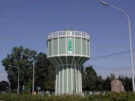

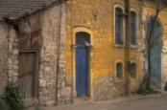

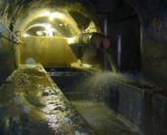
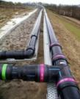
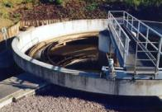

1. The water cycle : key players
Treatment
Storage
1. Extraction
Protection of wells
Municipalities
Municipalities
Municipalities
2. Supply
Municipalities
3. Public Waste water collection and treatment
Sewers
Collectors
Sanitation
“Environment”

Slide 4
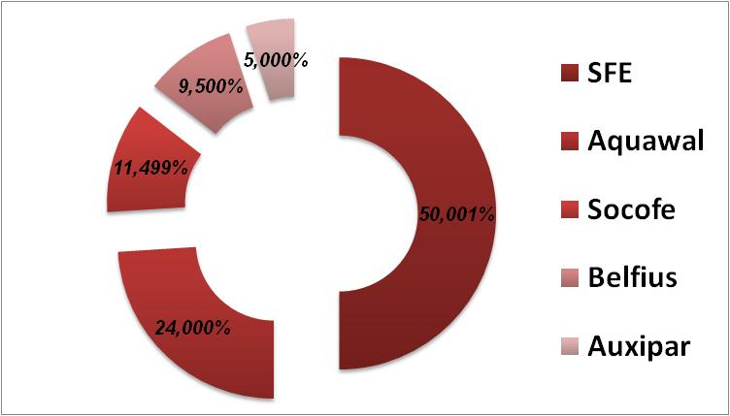





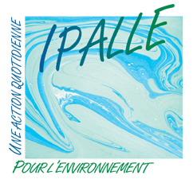

2. The waste water sector
  Choice of Public structure : Waste water policy is financed and coordinated by SPGE which in turn delegates to 7 WWT Inter-municipalities the implementation and operation of the infrastructures
SPGE Shareholders
Public majority guarented by law
Private
(80% SRIW-20% SWDE)
Has invested more than € 3 billion in 14 years
7 approved Waste Water Treatment Inter-municipalities

Slide 5
B. FINANCIAL POSITION AND PERFORMANCE

Slide 6

1. SPGE management general principles
Walloon Region
Capex
Determined
by SPGE
and approved
by Walloon Government
5-year revol. management contract
Water tariff
(2011-2016) / updated annually
Debt level
Balance sheet
Income statement
Own capital
€ 1.4 billion
Operating costs
€ 0.17 billion
Investments
€ 3.4 billion
Water fees
€ 0.26 billion
fund
cover
Debt stock
€ 1.8 billion
Debt service
€ 0.06 billion
As SPGE is designed to achieve a balanced position, its revenues are largely set in line with operating and capital expenditure levels and vice versa → near-zero net profit approach

Slide 7
2. Capital Expenditure
(€ million)
SPGE invested € 3.2 billion between 2000 and 2013 in improving its wastewater treatment infrastructure (coverage to most of the Walloon population)
SPGE plans to reduce its capex in the coming years as a result of now adequate compliance with sanitation targets set by the EU

Slide 8
3. Turnover : truth cost for wastewater treatment
Customer profit
Administrative simplification
Pooling of wastewater treatment costs amongst water users
Smoothing the overall increase in treatment costs over time
Outlook
Truth cost (in constant Euros) is expected to stabilize in the future. It is expected to increase at the same rate as the inflation rate (2020).
Water control Committee
gives an advice on each increasing of truth cost
approved by the Regional Minister of Economy
Truth cost 2015 | 1,935 / m³

Slide 9
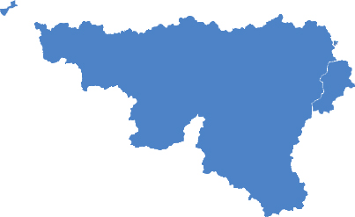
(3 bis. Reminder of the water pricing in Wallonia)
Walloon Region average for pour 100 m³ (1/1/2015)
Waste water Treatment
Contract 20 Y
PRODUCERS/
DISTRIBUTORS
Edit consumers invoices
Paid quarterly by producers
Production
35 %
Supply
60 %
Truth-cost for distribution
2,7839 €
(58,7 %)
Truth-cost for waste water treatment (SPGE)
1,9350 €
(40,8 %)
Protection of wells
5 %
Social Fund
0,0250 €
(0,5 %)
4,744 €/ m³ for 2015 + VAT of 6%
Notes:
9

Slide 10
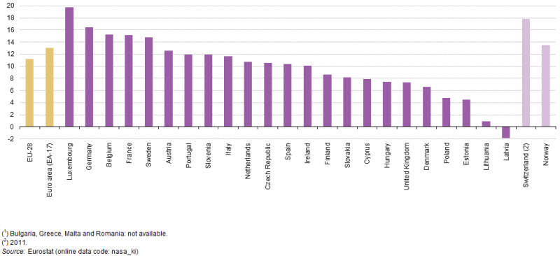
(3 ter. Water tariff…and saving rate)

Slide 11
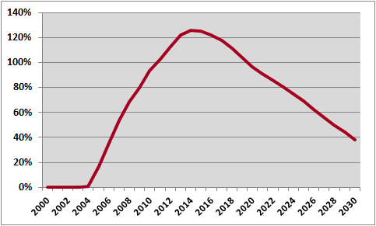

4. Debt-to-Equity Ratio
Ratio max
126%
Debt peak
€ 1.9 bi.
(x 1.000 € )
Equity
Debt
With capex reduction after 2015 and the anticipated increase in revenue, SPGE expects its net debt to peak € 1.915 billion in 2017
The ratio debt to equity is expected to peak at 126% in 2014, below the maximum level of 130% specified in the management contract

Slide 12
5. Debt-to-EBITDA Ratio
After 2017, SPGE cash flow is sufficient to decrease debt level substantially

Slide 13
C. DEBT AND RISK MANAGEMENT

Slide 14

1. Debt contex
The Walloon Region does not bring its direct guarantee to the loans levied by the SPGE
Constraints inherent to the stability pact
The guaranteed outstanding debt is already high
A. The Walloon Region authorizes irrevocably the SPGE to increase the water price to recover all its charges including financial charges
(= informal guarantee → Management contract)
Walloon Region
replace the failing producer after max. 40 days
B.
Insolvency
of the
co-contracting producers
C. The Walloon Region appoints 10 of the 15 board members directly or indirectly via its holding company

Slide 15

1 bis. Debt contex (Eurostat classification – ESA 2010)
SPGE is not included in the consolidation perimeter of the Walloon Region debt
SPGE (classification European System of Accounts = S11001) is an unit :
(1) institutional → autonomy (own goods, decision-making, keep a complete set of accounts)
(2) public → control (public ownership, appointment members board of Directors via WR, public control…)
(3) market producer (non financial)
(3a) sales to public sector < 50% → truth-cost charged to households and corporate
(3b) sales cover more than 50% of costs

Slide 16
2. Funding needs
Funding needs
171.3 M€
2015
186.6 M€
2016
219.6 M€
2017
106.4 M€
2018
683.9 M€
4 years
As of October 2015, SPGE has financed more than 100% of its € 171.3 million funding requirements for 2015
Since 2008 crisis, SPGE anticipates its funding needs from 6 to 9 months → SPGE is covered until June 2016
Debt amortization profile remains smooth

Slide 17

3. Liquidity
€ 210 million current short-term facilities
€ 35 million in confirmed credit facility with Belfius Bank
€ 100 million of CP program covered by back-up credit facilities
€ 75 million in ST investments readily available (on a total of 160)
Liquidity position is adequate and predectable
New funding of € 200 million signed with EIB
loan already approved for a 25 years maturity
could be used as credit facility during 2 years (CF of 10 bp)

Slide 18

3 bis. Liquidity (European Investment Bank)
◊ Appropriate « credit risk » approach
First fundings by EIB in 2005 but first contacts in 2002 with an appropriate credit risk approach for a non sovereign as SPGE
For private investors, to be able to get fundings by EIB is like a rating
◊ Big fundings
Maximum of 50% of the Capex → could be more than 50% of the debt because investments funded by own funds from the Walloon Region (= 1 billion Euros) could also be elegible by EIB
◊ Opportunity to use EIB funds as credit line facility with very low commitment fee

Slide 19


4. Debt structure and diversification
EIB loans
893.7 M€
43.8%
Average interest rate
Duration
Fixed rate
Bank loans & PP
662.3 M€
32.6%
2.85%
CP Program
≤ 1 year 149.7 M€
> 1 year 331.8 M€
7.4 years
481.5 M€
23.6%
92.2%
Gross Debt
2,037.5 M€
100.0%
234.0 M€
Cash invest.
137.9 M€
Cash invest.
October
2015
Net Debt
1,899.6 M€

Slide 20

5. Rating
Rating SPGE long term issuer A1
Rating SPGE short term issuer P1
Rating SPGE CP program P1
Outlook Stable
Moody’s Joint Default Analysis methodology for
government related issuers focus on 2 inputs :
A SPGE baseline credit assessment (BCA) of A3
High likelihood of support from the Walloon Region to prevent a default (SPGE’s public shareholding, reputation risk of the WR, SPGE’s strategic importance, the WR’s commitment to support SPGE in case of liquidity shortage)
Same rating as the
Walloon Region

Slide 21
6. Attractiveness of SPGE for investors ?
No formal guarantee from the sovereign but…
→ we concede “truth cost mechanism” or “public ownership” clauses
→ we concede “rating loss” clauses at Baaa (minus 4 grades)
→ we have a proximity to the cash flow (truth cost paid by the consumer)
Documentation
→ we provide standard under Belgian, German or English law
→ we provide own legal opinions
→ we can ensure a listing of the issuing (Luxemburg, Frankfurt,…)
Flexibility and proactivity
→ Quick approval from the management (we can deal in a week)
→ As we anticipate our funding needs, we are more flexible
Spreads and maturity
→ Our benchmark is Belgian obligations + about 45 bp and, with a duration of 7.7 years, we now favor more MT maturities (4-6 and 10-15years)

