Slide 1
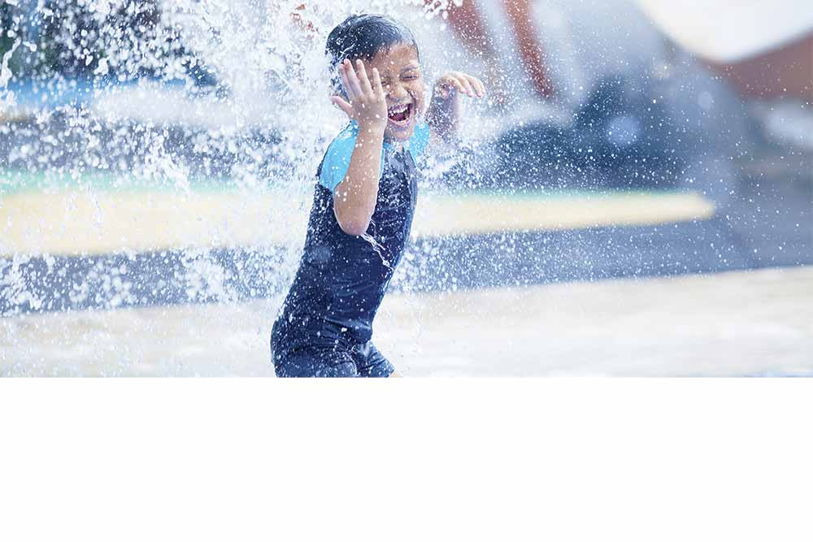
Welcome to EurEau
Presentation to EVEL
29 October 2015, Brussels

Slide 2
Overview
Who are we?
What do we do?
Our priorities
How we work
EurEau and EU
EurEau and you

Slide 3
Who are we?
EurEau
the voice of
Europe’s
Water sector
since 1975
Our
members
are the
national
water
services
associations
from 28
European
countries
We
represent
public and
private
drinking
and waste
water
services
providers
Employing
500,000
people,
the sector
makes
a significant
contribution to
the European
economy

Slide 4
2. What do we do?
We provide a network for our members to share knowledge and ideas, exchange best practices, analyse common problems and develop effective solutions.
We engage with EU policy makers to highlight the role water services play and influence European legislation so as to respond to the common challenges shared by the European water sector.
Notes:
Network: stress our established members from bigger countries have just as much to learn from the Estonians as the Estonians have from everyone else.
Engage:
We reinforce and make visible the important role that water services play.
We aim to shape European legislation to address the following challenges:
1. access to water
2. water quality
3. resource efficiency.

Slide 5
2. What do we do?
We provide networking opportunities for EurEau members to meet with representatives of the European institutions.
We identify partners beyond the water sector to work with.

Slide 6
3. Our priorities
Protecting water resources from pollution.
Securing investments for the water sector by applying an appropriate pricing policy.
Promoting the sustainable use of resources through the circular economy.

Slide 7
4. How we work
Governance structure:
Executive Committee
General Assembly
3 Commissions (EU1: drinking water; EU2:waste water; EU3:economic and legal affairs).
Together, we formulate policy positions on key issues that impact on the water sector and advocate for them in the European institutions.
Notes:
Mention the WLG – unofficially of course!

Slide 8
4. How we work – general secretariat
Core team of four people – exceptional value!
We need to ensure we respond to information requests quickly.
Focus on what we can agree on – this is our strength.
Key roles
Support policy development.
Lobby and communicate for members in Brussels.
Key recent successes
Maintaining contacts with the Commission and in the EP.
Keeping EurEau in the political debates involving water.
Notes:
Focus on what we can agree on – this is our strength to the Commission and EP.
Lobby and communicate – we are the eyes and ears; we keep our members informed of what is going on here and advise them on how to act to achieve our common goals. We are a lobbying, PR, policy think tank all in one.

Slide 9
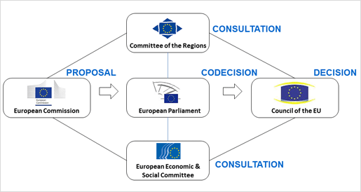
5. EurEau and EU
Notes:
The EC is the institution that proposes legistation.
Meeting – We met with the head of the Water Unit in DG Envi, Pavel Misigai. The Commission's environment directorate fully supports our policy objectives and will continue to help us collaborate with other Commission departments. said our initiatives on the Circular Economy and micro-pollutants were essential.

Slide 10
European Commission
EurEau attends and influences the EC Expert Groups meetings of the DWD, UWWTD, BWD.
EurEau attends and influences the meetings of the Common Implementation Strategy (CIS) of the WFD.
EurEau is part of the European Innovation Partnership (EIP) on Water and Water Joint Programming Initiative (JPI).
EurEau regularly meets relevant European Commission’s officials in bilateral meetings.
Notes:
The EC is the institution that proposes legistation.
Meeting – We met with the head of the Water Unit in DG Envi, Pavel Misigai. The Commission's environment directorate fully supports our policy objectives and will continue to help us collaborate with other Commission departments. said our initiatives on the Circular Economy and micro-pollutants were essential.

Slide 11
5. European Commission
New European Commission since Nov 2014
10 priorities: including jobs, growth, investments.
European Commission work programme 2015
DWD evaluation.
Cost of chemicals legislation.
Water reuse not in the list of 2015 legislative proposals.
WFD review by 2019.
Notes:
EP
Intergroup – it is now the Intergroup on biodiversity, climate change, sustainable dev – with a Water& Agri WG. Meeting on «Access to Water» and «micropollutants in water».
WLG in internal communication.

Slide 12
European Parliament
EurEau sponsors the EP Intergroup on biodiversity, climate change and sustainable development, cooperating with the working group ‘agriculture and water management’.
EurEau regularly meets MEPs on relevant topics in bilateral meetings.
EurEau follows the relevant parliamentary committees and shares with MEPs voting recommendations.
Notes:
The EC is the institution that proposes legistation.

Slide 13
5. What topics do we work on these institutions with?
Right2Water
Micropollutants
Microplastics
Circular economy and recovery
Water reuse
Benchmarking and transparency.
Notes:
R2W
The Parliament’s call to guarantee the human right to water and sanitation is welcome but its report lacked clarity on key issues. The report rightly concludes that Member States must put in place social policy instruments - such as water affordability mechanisms - to guarantee access to water and sanitation for people who are unable to afford these vital services. However, the Parliament’s report could have focused more on how water services are provided and not on who provides them, since the governance system is a choice for Member States.

Slide 14
Other stakeholders
Other water organisations (World Water Council, IWA, WssTP, APE, EWA)
CEEP
European Benchmarking Cooperation Foundation (EBCF)
Aquabench
WAREG (Water Regulators)
Pharmaceutical Industry (EFPIA, EGA, AESGP)
Pesticides producers (ECPA)
Farmers (COPA COGECA and CEJA)
European Sustainable Phosphorus Platform (ESPP)
Coagulant producers (INCOPA)
European Chemical Industries (CEFIC)
European Green NGOs (EEB, Chemsec)
Consultancies (Deloitte, Milieu, Ramboll).

Slide 15
6. EurEau and you
~ Website
~ Intranet
~ Newsletter
~ Social media
~ EurEau Annual Report 2016.
Notes:
We also offer further training on what happens in Brussels, lobbying, how it works here.

Slide 16
Thank you
for your attention
Neil Dhot: neil.dhot@eureau.org
Caroline Greene: caroline.greene@eureau.org
Bertrand Vallet: bertrand.vallet@eureau.org
Carla Chiaretti: carla.chiaretti@eureau.org
Rue du Luxembourg 47-51,
B-1050 Brussels, Belgium
Tel: +32 (0)2 706 40 80
Fax: +32 (0)2 706 40 81
BE 0416 415 347
secretariat@eaureau.org
www.eureau.org
EurEau. Water Matters.
www.eureau.org

