Slide 1
The BSAP Fund
The Fund was set up in 2010 to speed up the implementation of the BSAP plan
NIB and NEFCO are joint managers of the Fund. Sweden has committed SEK 90 million (EUR 9 million) and Finland EUR 2 million
The Fund has approved nearly 40 projects per today
The projects are spread across the Baltic Sea Region from Russia, Poland, Estonia to Sweden and Finland as well as the Baltic Sea catchment area in Belarus

Slide 2
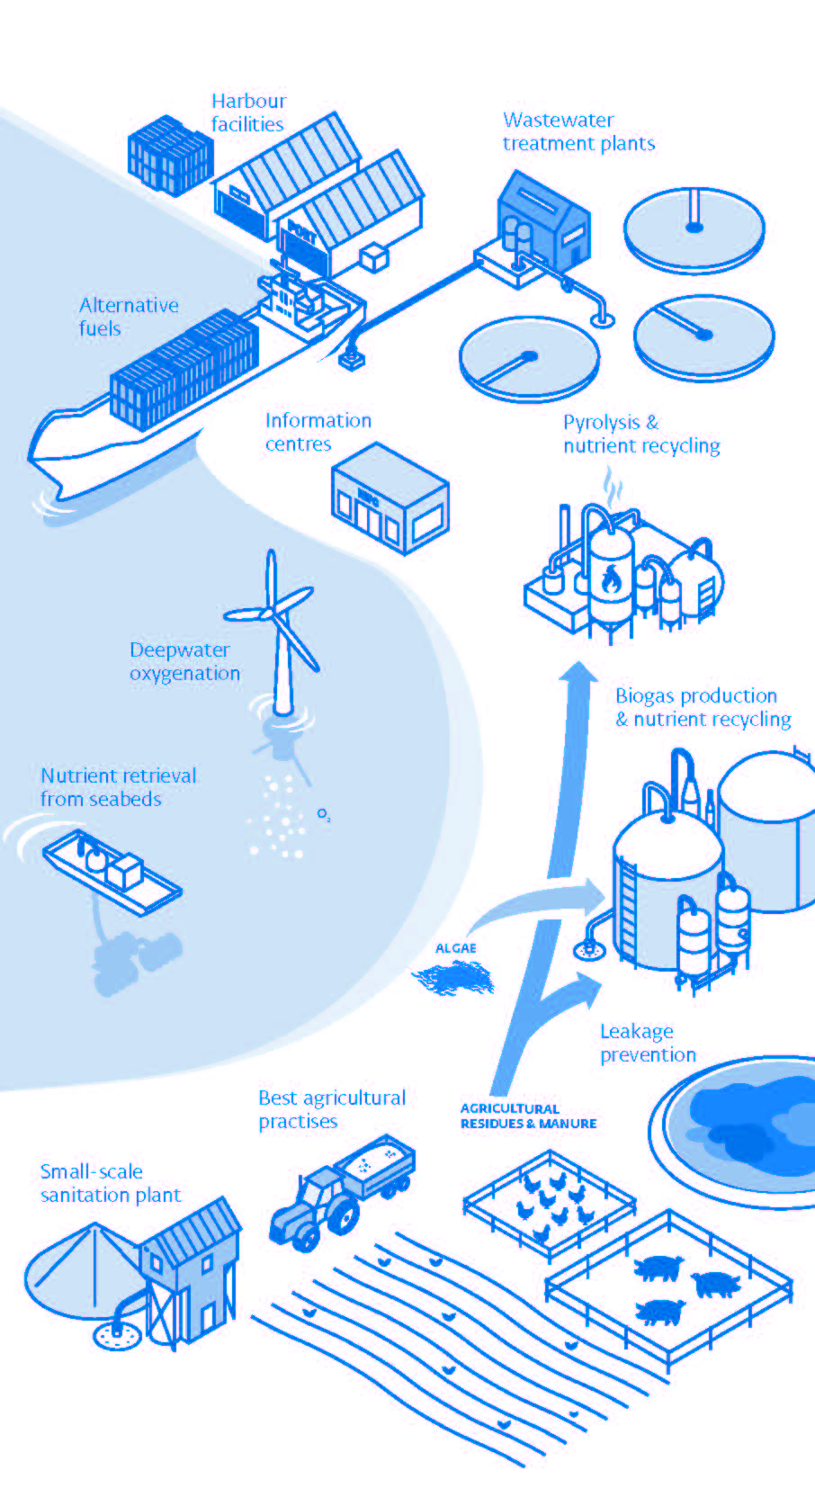
BSAP Projects
Biogas production with nutrient recycling
Best agricultural practices
Pyrolysis and nutrient recycling
Deepwater oxygenation
Nutrient Retrieval from seabeds
Waste water treatment plants
Small scale sanitation plant
Leakage prevention
Alternative fuels
Harbour facilities
Information centres

