Slide 1
Financing in water sector - times of change
Antti Tooming
Ministry of the Environment / Water department, Head of Project bureau
19/05/2016

Slide 2
Themes
Goals to achieve
Available resources
Current situation
Future development

Slide 3
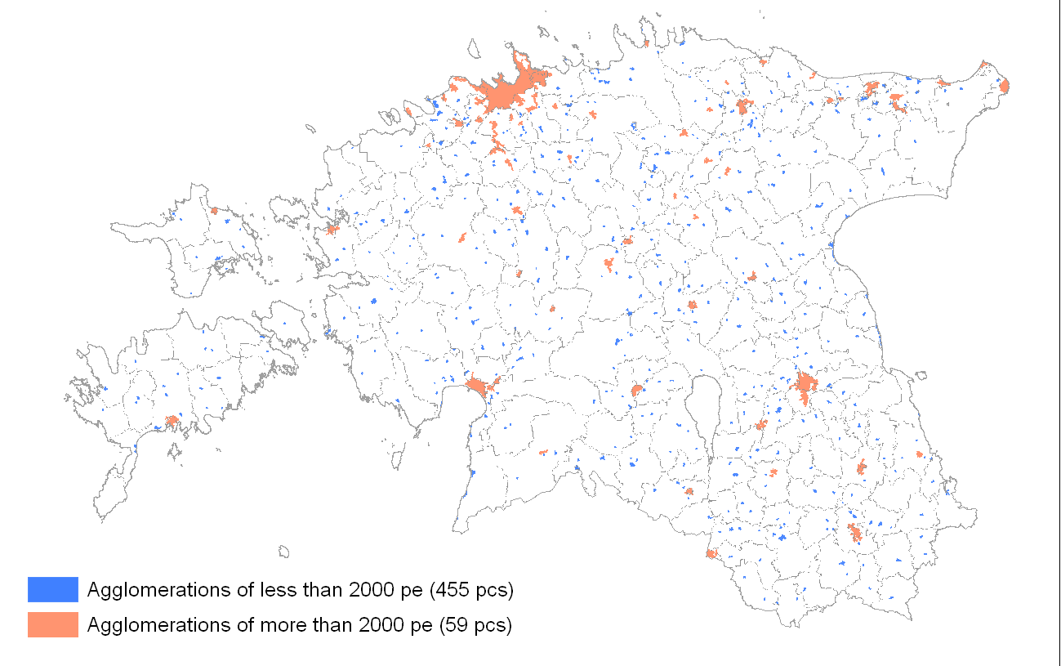
Background information
1,6% of Estonia's land area is covered by agglomerations

Slide 4
Goals to achieve
Accordance with EU drinking water and urban wastewater treatment directives with EU 2014-2020 financial period
Agglomerations more than 2000 p.e are economically sustainable after EU 2014-2020 financial period
Independence from financial aid
Efficiency, innovation, consolidation in water sector
Clear and solid legislative base
Notes:
- Üle 2000 ie RKA-d pärast EL 2014-2020 perioodi finantsiliselt jätkusuutlikud

Slide 5
Available resources
Significant investments from EU 2007-2013 financial period - 630 MEUR allocated to water infrastructure
2014-2020 EU financial period - 141 MEUR to water infrastructure projects
Environmental Investment Centre (EIC) environmental program –15 MEUR/year, future 5-10MEUR!?
Water companies and municipalities own financing – approx. 30-50 MEUR/year

Slide 6
Current situation
Indicator/ year | 2004 | 2007 | 2015
Share of Estonian population connected to public water supply system | 77% | 84% | 88%
Share of connected population receiving drinking water meeting all the requirements | 68% | 65% | 97%
Share of Estonian population connected to public sewerage system | 72% | 75% | 85%
Accordance with urban wastewater directive for agglomerations more than 2000 pe | 55% | 62% | 82%

Slide 7
Current situation
Available resources have been drastically decreased in both EU and state funding
Budget cuts have affected also EIC environmental program, approx. 50% decrease annually since 2016
Change of legislative base - public water and sewerage act since 1999, amendment
Water price is under State control since 2010
Financing of water projects is state aid since 2015
Notes:
Competition Authority approve the application of water price for agglomeration areas with the pollution load more than 2000 p.e. and local municipality for the agglomeration areas less than 2000 p.e.

Slide 8
Future development
Clear financing priorities for achieving the accordance with drinking water and urban wastewater treatment directives
Financial aid only in the amount that cannot be covered from the water tariffs
Minimum water tariffs will be taken into account for aid calculation (1,5% per houshold)
The price for water services has to cover operating expenses and investment needs and achieve the sustainability of the systems
Sustainability in long term is a key factor (water pricing)
Notes:
Üldist majandushuvi pakkuv teenus- teenus, mis ei ole vabas turumajanduses teostatav.

Slide 9
Water pricing
In 2000 average water price was 0,99 eur/m³;
In 2015 3,0 eur/m³;

Slide 10
Summary
Financial aid for agglomerations more than 2000 pe until 2020, further own financing and loans
Smaller agglomerations probably need state financing due to lack of own finance in the future
Sustainability and enchanced efficiency in water sector
Adequate water pricing
Enlargement of regional water companies
Notes:
Adequate water pricing regulation
To achieve the balance between sustainability of water companies and affordability of water services;
Self-effiency
Innovation
Peab suutma sinna jõuda, et suuremad st üle 2000ie vee-ettevõtted on isemajandavad. See oli ka EL perioodi 2014-2020 ÜF vahendite saamise eeltingimus, et me väljuksime pärast seda perioodi toetussõltuvusest.

Slide 11
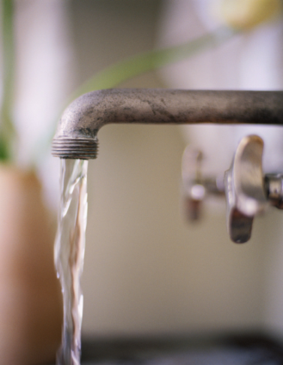
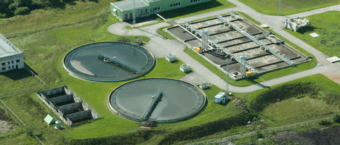
Thank you for your attention!

