Slide 1
Waste Water Management Case: Tallink Silja Ab
Hans Friberg
DP of Tallink Silja Ab

Slide 2
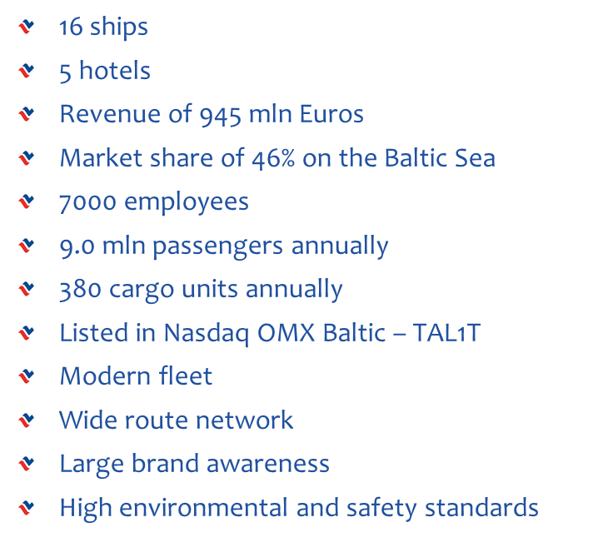
Tallink in Brief

Slide 3
Environmental policy
The principles of environmental protection are integrated into the company`s main strategy
The environment is protected against marine-, air and other pollution
Ships are maintained and operated according to the MARPOL convention
The ships have the high level international environmental certificate ISO 14001:2004
The company is preffering environmentally aware cooperation partners

Slide 4
Major areas of attention
Strict requirements and legislation
IT and hardware innovations
Chemical solutions
All waste waters left ashore
Zero tolerance to spills
Intelligent solutions
Recycling and waste management
Office buildings with smart energy solutions
Responsible onland logistics

Slide 5
Destination Ports
Stockholm – Värtahamn, Frihamn
Tallinn – D-terminal
Helsinki – Western Harbour, Southern Harbour, Vuosaari (cargo traffic)
Turku – Turku Harbour
Aland Islands – Mariehamn, Långnäs
Riga – Riga Freeport
Paldiski (cargo traffic)
Kapellskär (cargo traffic)

Slide 6
Tallink Grupp`s vessels

Slide 7
Sewage treatment plants onboard our ships, improvements
GW Collecting tanks onboard with capacity to store up to 400 m3 treated sewage water.
Increased capacity of GW discharge pumps up to 300 m3/hour.

Slide 8
Sewage receiving facilities in linked ports
Helsinki – 5 ships discharging into shore pipeline, FREE of charge, average 700m3/day
Stockholm – 7 ships discharging into shore pipeline, MONTHLY FEE + 40% in case H2S* limit is exceeded, average 1500 m3/day
*(Hydrogen sulfide is slightly soluble in water and acts as a weak acid. A solution of hydrogen sulfide in water, known as sulfhydric acid or hydrosulfuric acid, is initially clear but over time turns cloudy.)

Slide 9
Sewage receiving facilities in linked ports
Riga – 1 ship discharge is limited to max 200 m3 per visit, FIXED FEE calculated per GT of the ship, average 100 m3 per day
Tallinn – 2 ships discharging to shore pipeline, max discharging rate limited to 80 m3/hour, receiving of the sewage may be refused if limits set by local waste water company is exceeded, 7 m3 free per visit, average 200 m3 per day

Slide 10
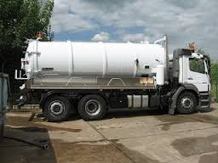
Sewage receiving facilities in linked ports
Paldiski – 1 ship, discharge to truck only,
7m3 free and rest is charged per m3, MOST EXPENSIVE due to the transportation cost, average 20 m3 per day (Ro-Ro ship)

Slide 11
Main things to consider when deciding where and how to discharge sewage:
Shore receiving facilities availability
Shore system receiving capacity
Cost of discharge
Restrictions to the sewage water quality
Time limits

Slide 12
Recommendations to consider when planning design of onboard sewage handling systems:
Food and bio waste to be separated from sewage water (installation of food waste handling systems).
Additional aeration of sewage collecting tanks to decrease H2S level.
Keeping STP running in spite of shore discharge availability in order to keep disharged sewage water characteristics within allowable limits.

Slide 13
And as last, but not the least...
Please engage in saving the smallest seal species in the world – the Baltic ringed seal
WWF Finland and AS Tallink Grupp have started a donation campaign to start research supporting the survival of this species
Everyone who makes a donation to this project is invited to digitally write their name on board of Tallink’s new vessel, Megastar

Slide 14
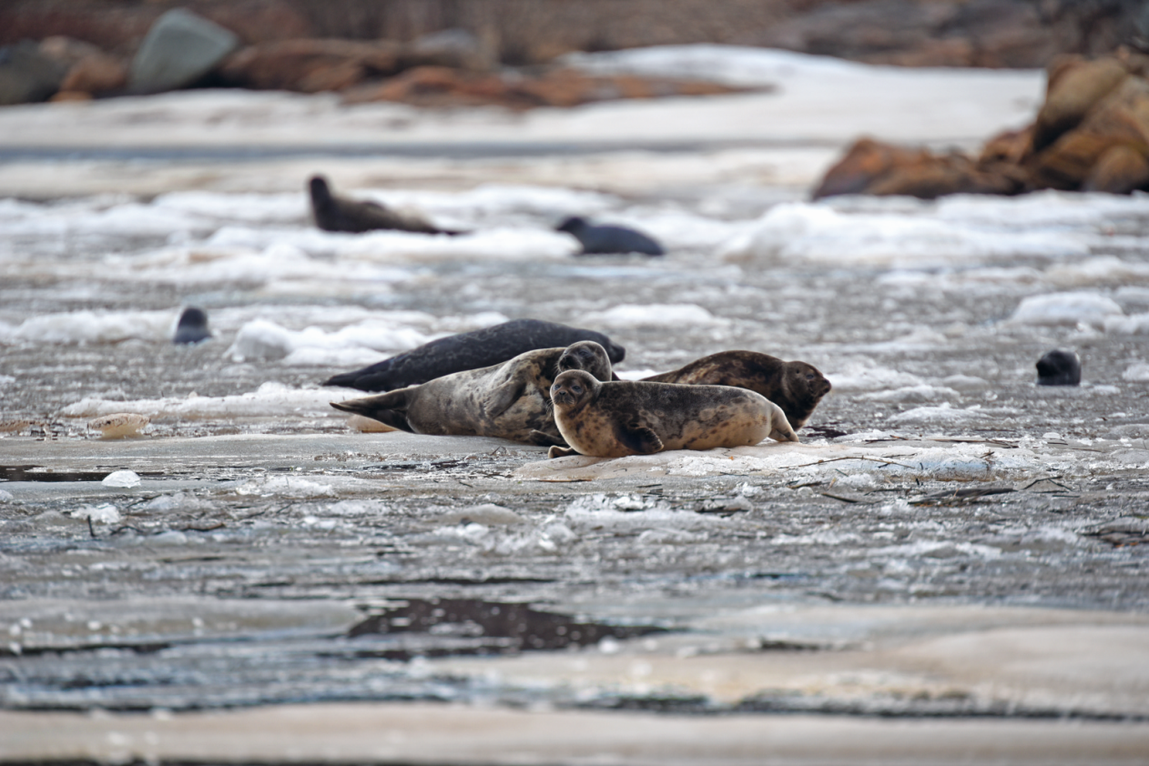
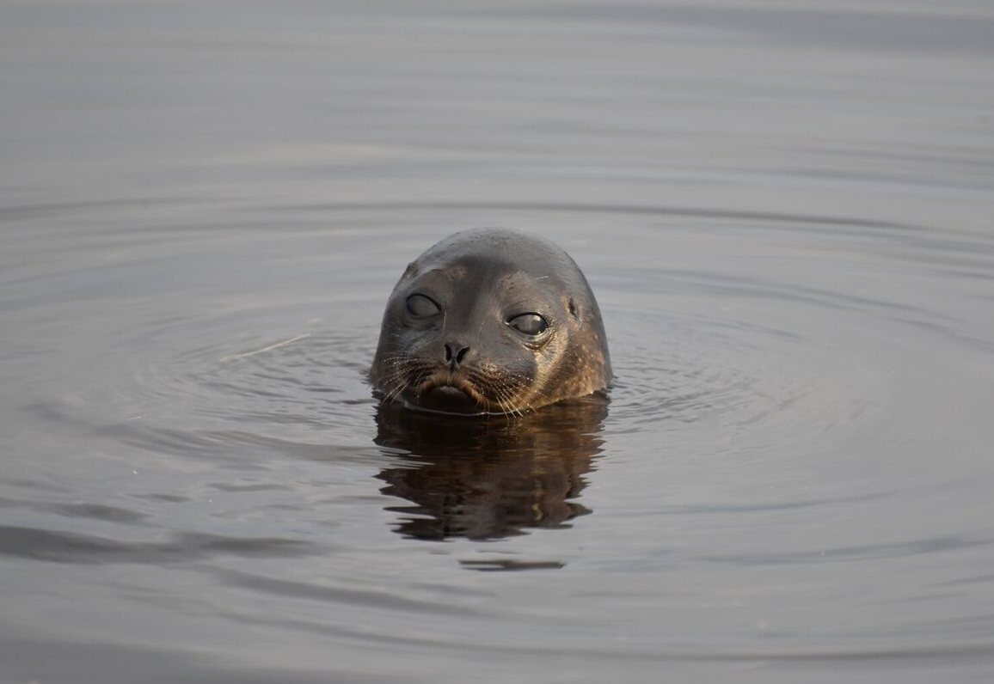
http://oma.wwf.fi/tallink
@Mervi Kunnasranta/WWF

