Slide 1

Drinking water quality effect on the corrosion of the cast iron pipes
Dr.Sc.ing. Kamila Gruškeviča
Riga Technical University
www.wrl.bf.rtu.lv

Slide 2
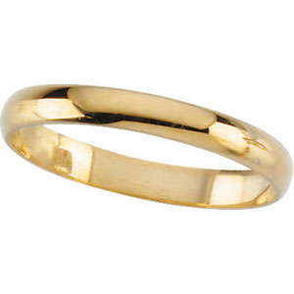
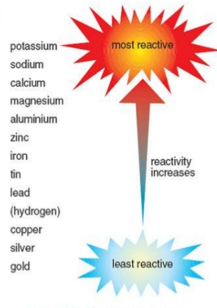
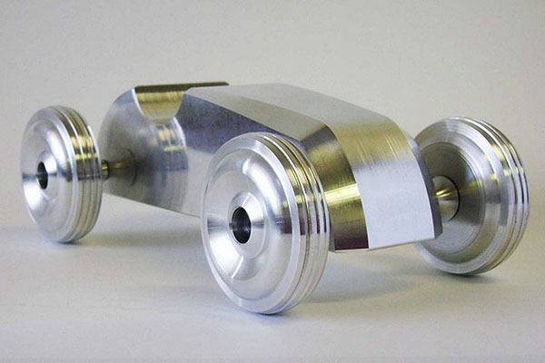
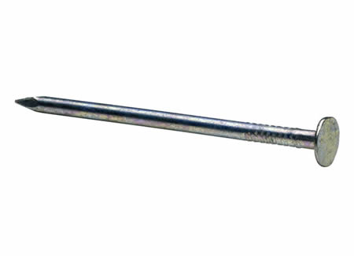
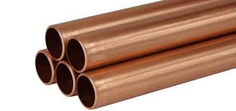
Environmental conditions

Slide 3
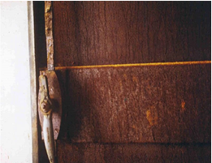
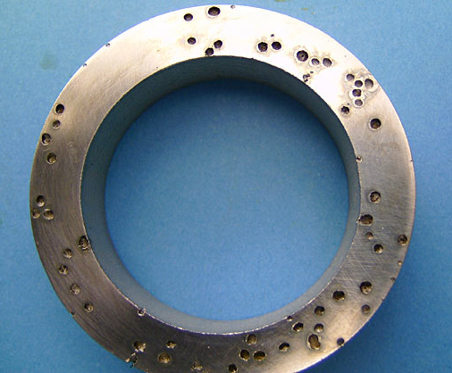
Iron Corrosion types
uniform
galvanic
tuberculation

Slide 4
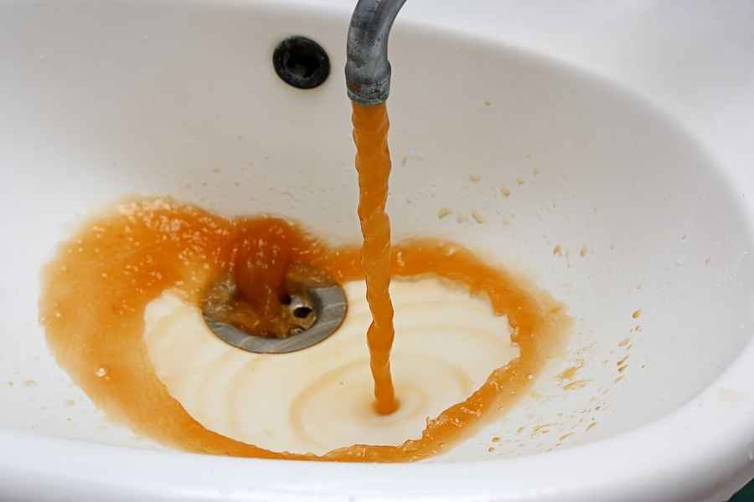
Corrosion related problems:
Increase of pumping costs due to increase of pipe wall roughness and water turbidity;

Slide 5
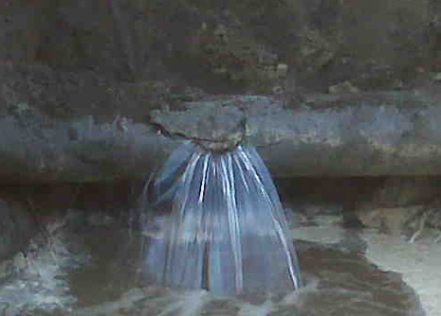
Corrosion related problems:
Water loss because of leakages;
Damage or pipes and armatures because of water aggressiveness

Slide 6

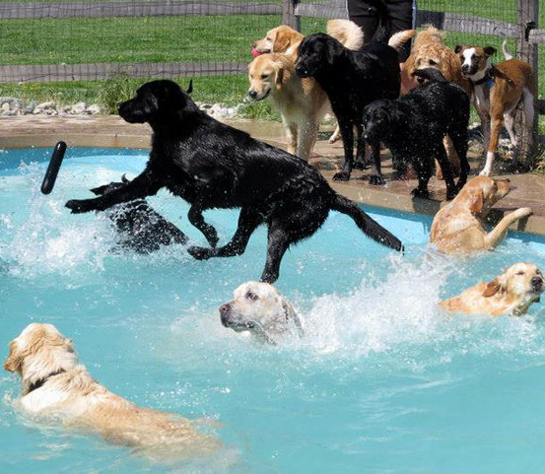
Corrosion related problems:
Necessity of increase of chlorine doses to maintain regulatory amount of residual chlorine;

Slide 7
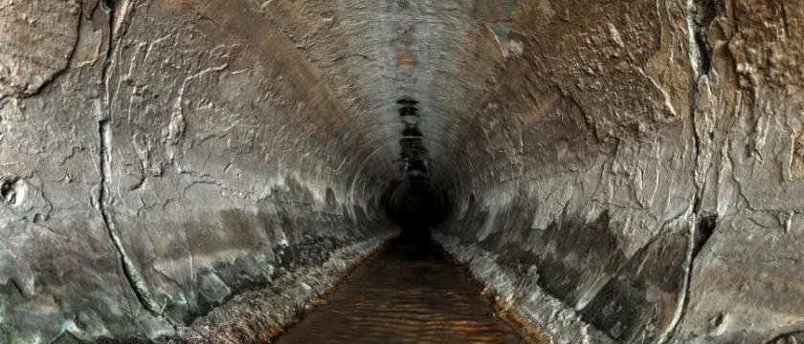
Corrosion related problems:
Increase of costs of wastewater treatment and handling.

Slide 8
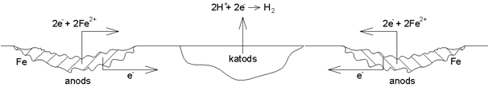
The corrosion of steel in case of closely located anode and cathode
Notes:
Metāla oksidācija un noārdīšana notiek uz anoda. Elektroni, kas atbrīvojas anoda reakcijas dēļ, pārvietojas uz katodu, kur viņi pāriet pie akceptora, piemēram, skābekļa. Pozitīvos jonus, kas ģenerējas uz anoda, pievelk katods un otrādi. Šī migrācija notiek kā koncentrācijas gradientu maiņas rezultāts, lai uzturētu elektriski neitrālu vidi.

Slide 9
Factors affecting corrosion:
Dissolves gasses, especially oxygen;
Dissolved and suspended solids and particles;
pH;
alkalinity;
hardness;
temperature;
water flow velocity;
microbiological activity.

Slide 10
Corrosion – what is inside?

Slide 11
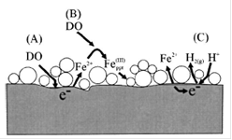
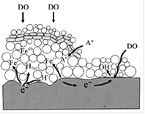
Corrosion process

Slide 12
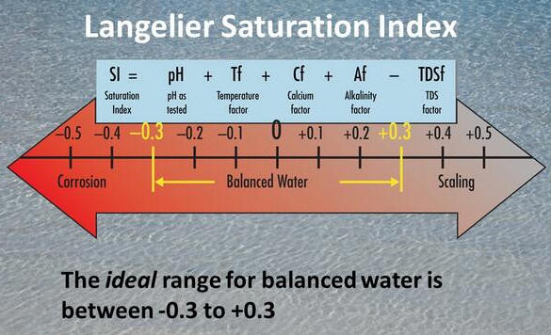
Corrosion indexes
Langelier saturation index (LI) indicates the posibility of solubility or precipitation of calcium carbonate in water systems.
LSI > 0 Water is oversaturated and CaCO₃ precipitates.
LSI = 0 Equilibrium conditions.
LSI < 0 Water is unsaturated and no protective layer can be formed.

Slide 13
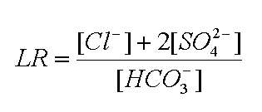
The Larson-Skold index describes the corrosivity of water towards mild steel
LR < 0,8 Chlorides and sulfates do not affect the formation of natural protective layer.
0,8 < LR <1,2 Chlorides and sulfates may interfere with natural film formation. Higher than usual corrosion rates.
LR > 1,2 The tendency towards high corrosion rates of a local type should be expected.

Slide 14
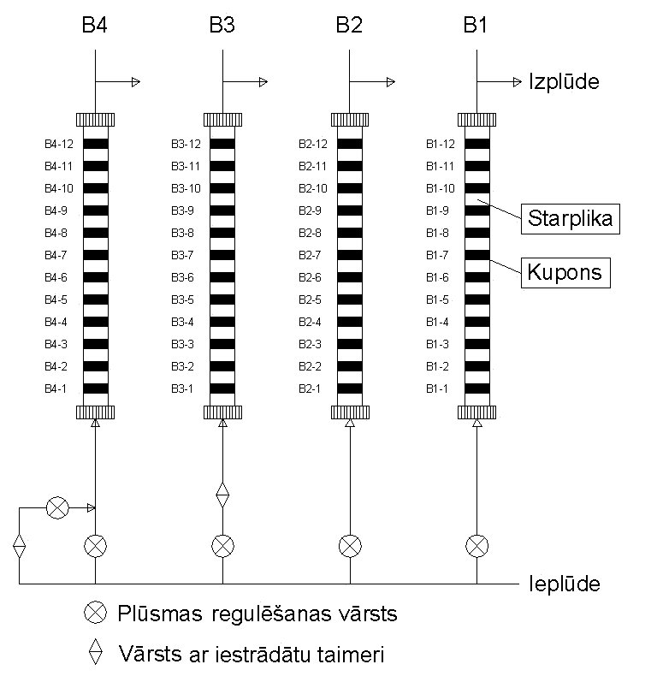
Corrosion experiments
Flow rate
B1 0.35 m/s
B2 0.05 m/s
B3 0.35 / 0 m/s
B4 0.35 / 0.05 m/s

Slide 15
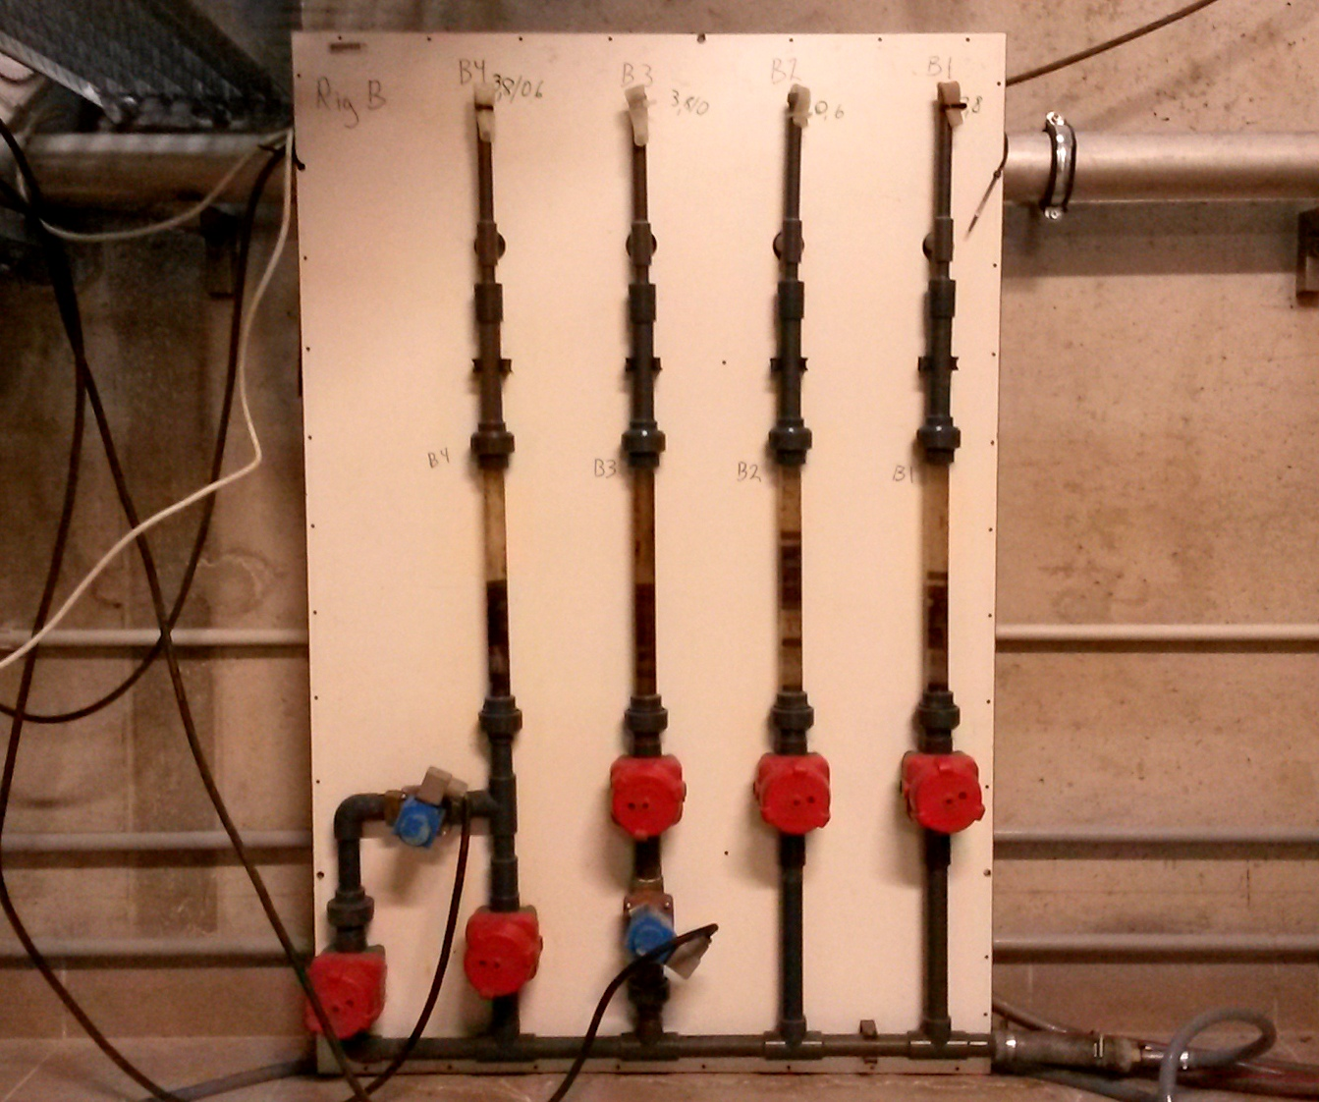

Slide 16
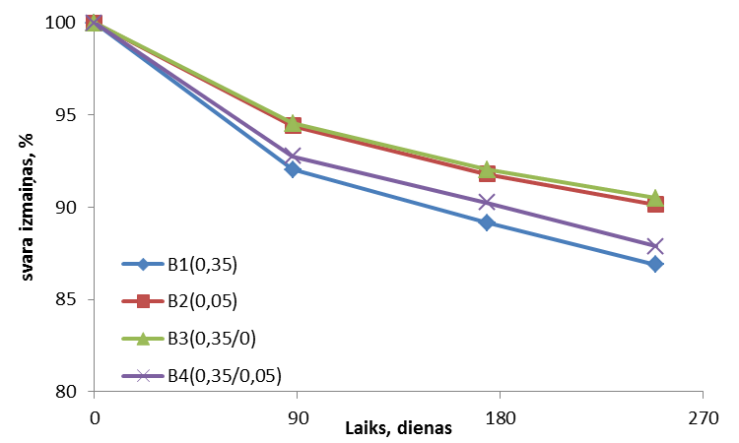
Example 1 (LSI = 0.7)
Weight changes, %
Time, days

Slide 17
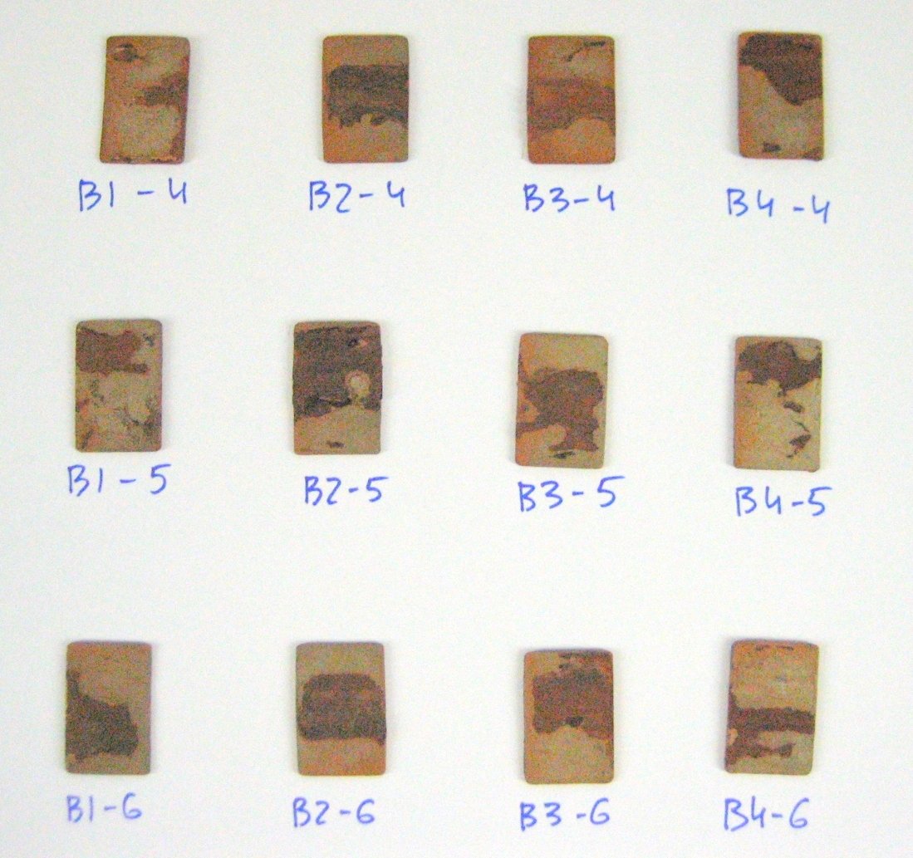
coupons
Parameter | Average (n=12)
pH | 7,57
Ca, mg/L | 63,36
Alkalinity, mmol/L | 3,01
Temperature, °C | 10,62
Sulfate, mg/L | 61,09
Chlorides, mg/L | 117,5
EC, µS/cm² | 754
Turbidity, NTU | 0,54
RedOx, mV Ag/Cl | 257,82

Slide 18
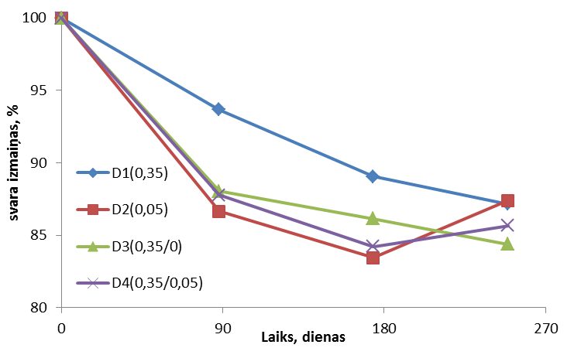
Example2 (LSI = -0.1)
Weight changes, %
Time, days

Slide 19
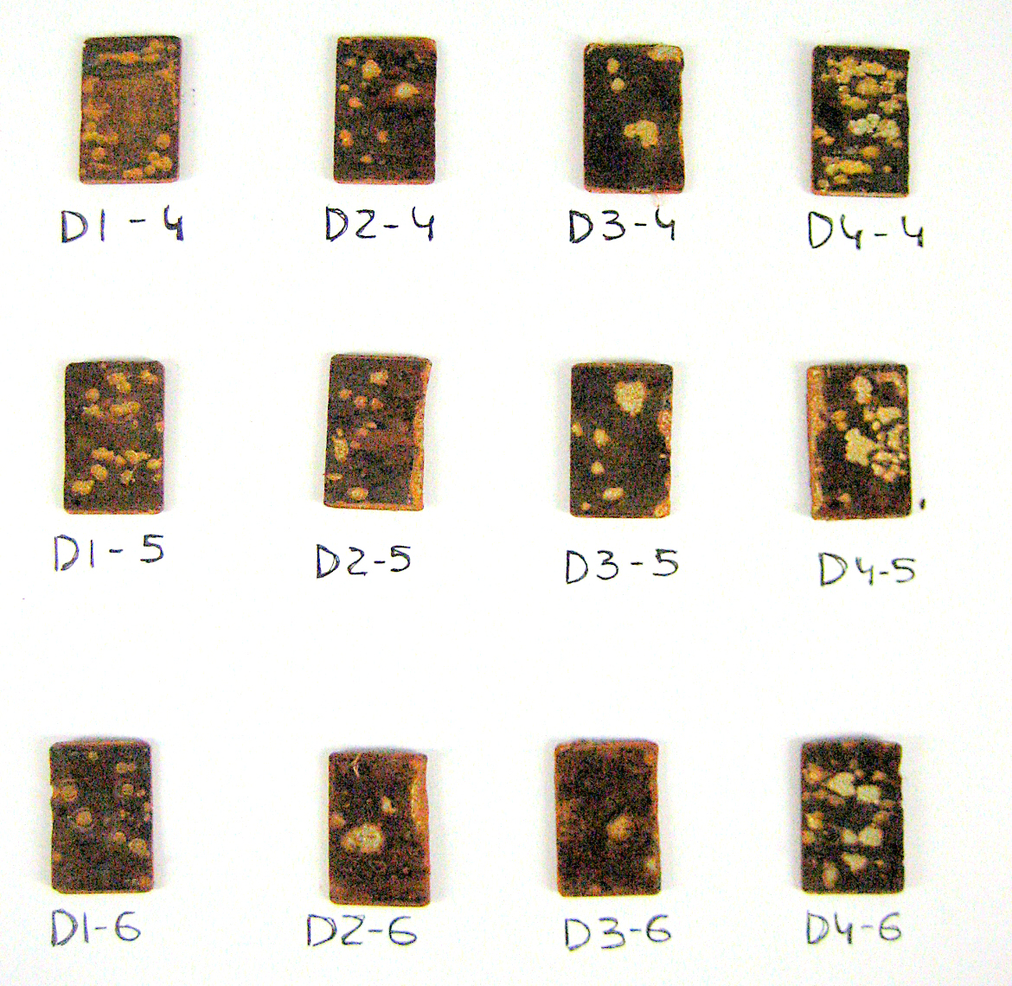
Coupons
Parameter | Average (n=12)
pH | 6,91
Ca, mg/L | 52,13
Alkalinity, mmol/L | 2,13
Temperature, °C | 8,65
Sulfates, mg/L | 121,81
Chlorides, mg/L | 7,47
EC, µS/cm² | 358
Turbidity, NTU | 0,195
RedOx, mV Ag/Cl | 260

Slide 20
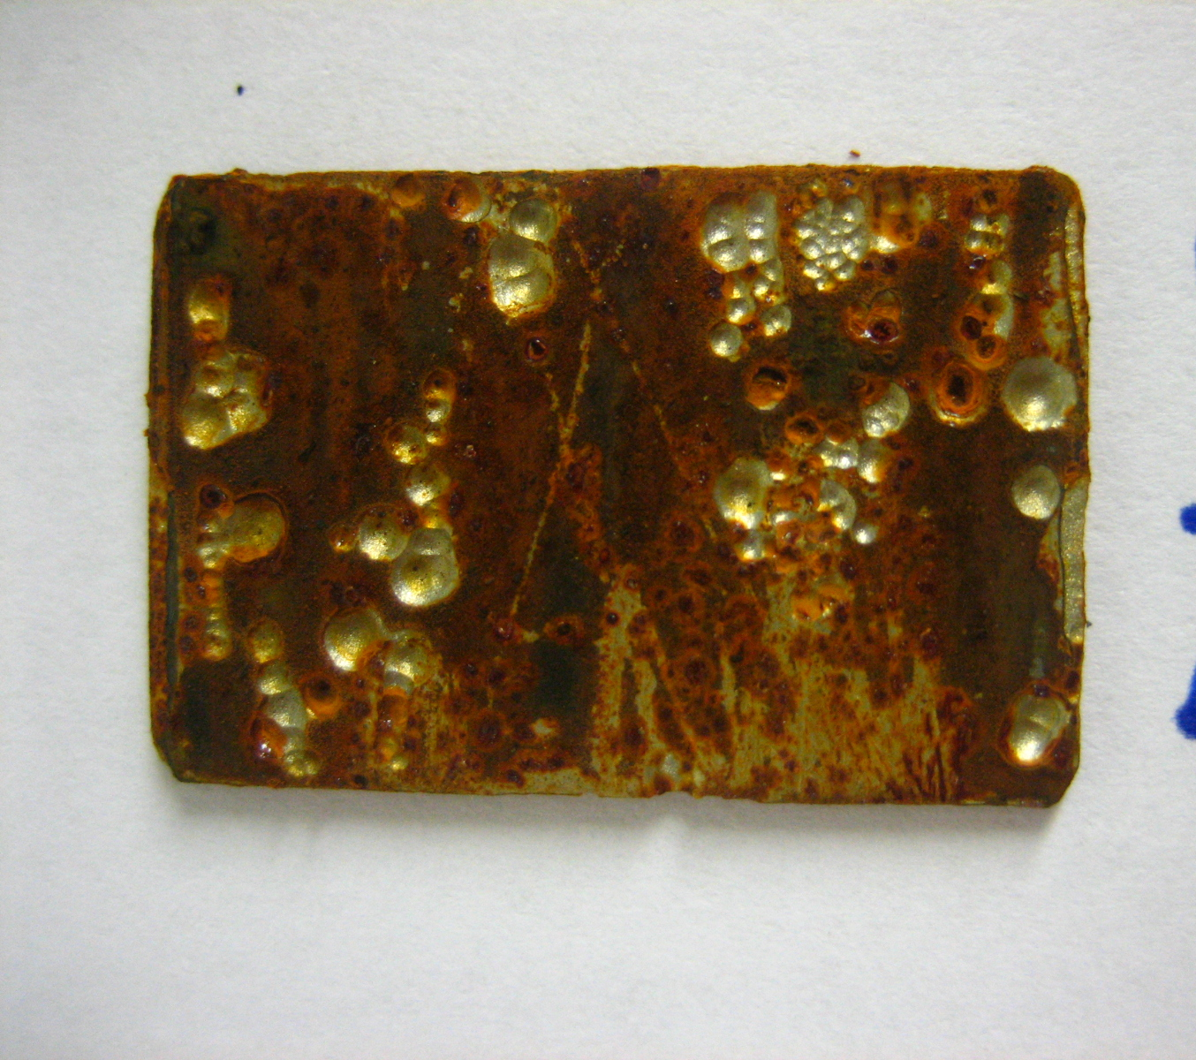

Slide 21
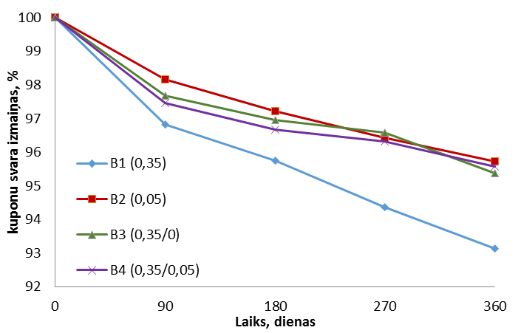
Example 3 (LSI = -0.36)
Weight changes, %
Time, days

Slide 22
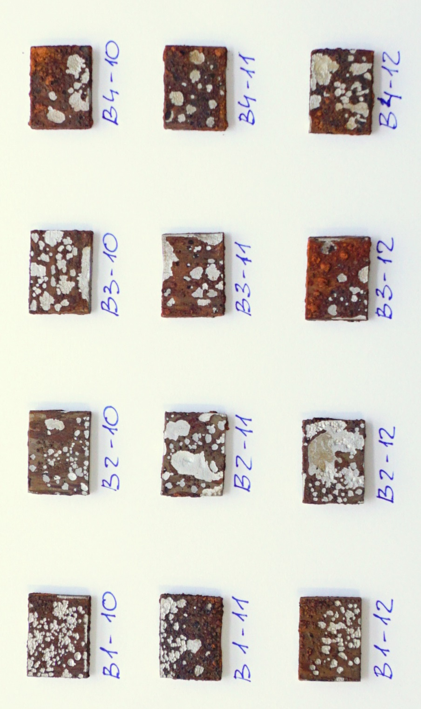
coupons
Parameter | Average (n=12)
pH | 7,52
Ca, mg/L | 67,56
Alkalinity, mmol/L | 4,17
Temperature, °C | 13,31
Sulfates, mg/L | 182
Chlorides, mg/L | 30,4
EC, µS/cm² | 901
Turbidity, NTU | 0,54
RedOx, mV Ag/Cl | 267

Slide 23
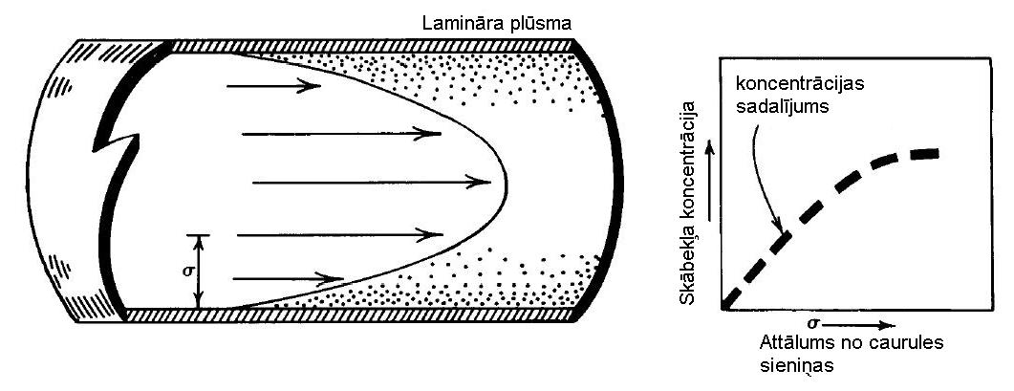
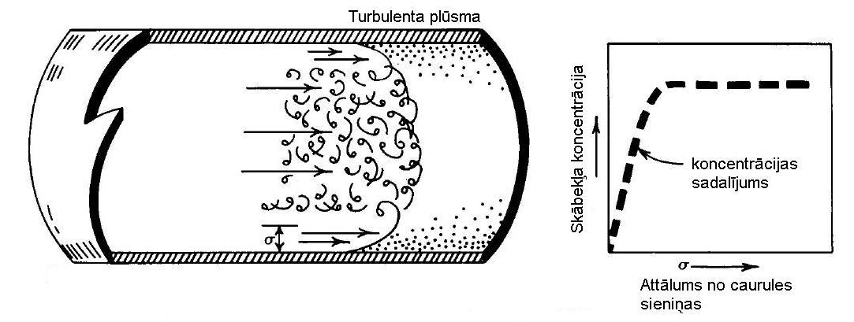
Oxygen diffusion in different flow conditions

Slide 24
Thank you for your attention!
Tallinn
20.05.2016

