Slide 1

Drinking water network flushing: tool to save water quality
BALTIC WATER WORKS CONFERENCE 2016
Dr.Sc.ing., assoc.proff. Jānis Rubulis
Riga Technical university
www.wrl.bf.rtu.lv/en/
janis.rubulis@rtu.lv
mob.phone.+37129438018
Tallink M/S Victoria I
19.05.2016

Slide 2
DN 100-200 network flushing
Effective
World-wide used
Tested In latvia
Notes:
I can help

Slide 3
structure of presentation
Problem definition
Solution – unidirectional flushing
Experience
costs
chalenges and future trends

Slide 4
Problem definition

Slide 5
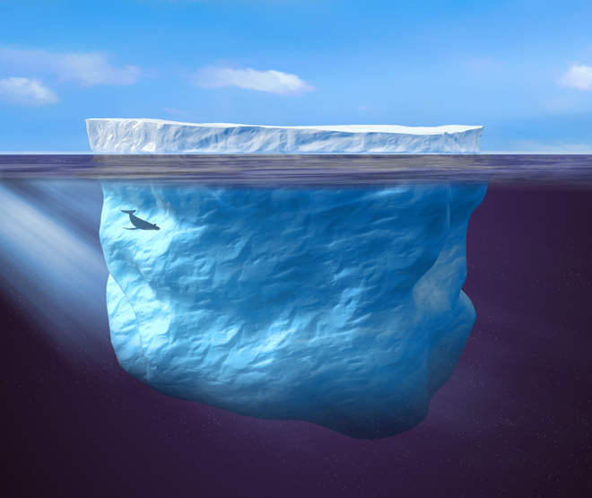
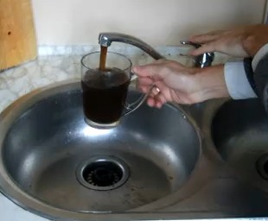
Discoloraton Complain statistics
60-80% Australia (Rayan et. al 2003)
80% Japan (Matsui et. al 2007)
70% Latvia (Neilands et al, 2009)
80% UK (Husband and Boxall 2011)
Riga: 0.07 complain/1000 consumers/year
Netherlands: 0.5-1 complain /1000 consumers/year
UK: 4 complain /1000 consumers/year
Australia: 1.1-17.9 complain / consumers/year
Zabašta et al, 2014; WSAA Facts 2005
www.wired.com

Slide 6

Customers interviews
Consumers use tap water for drinking, but they boil it before use, resulting in perception that it is “safer”.
They feel that good water is spoiled by the old, bad quality water pipes.
Concern about Tap Water

Slide 7
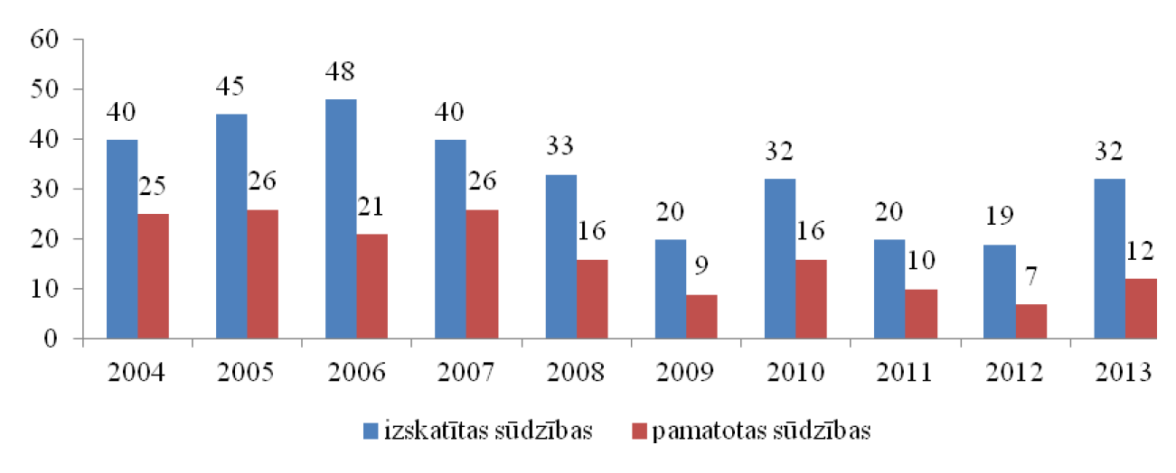
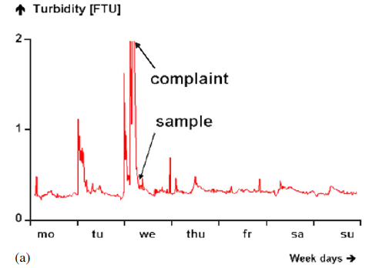
Complains
reviewed
confirmed
Vreeburg un Boxall, 2007

Slide 8
Customers interviews
Relations Between the Consumer and the Water Supplier
Customers feel that they receive little information from their supplier.

Slide 9
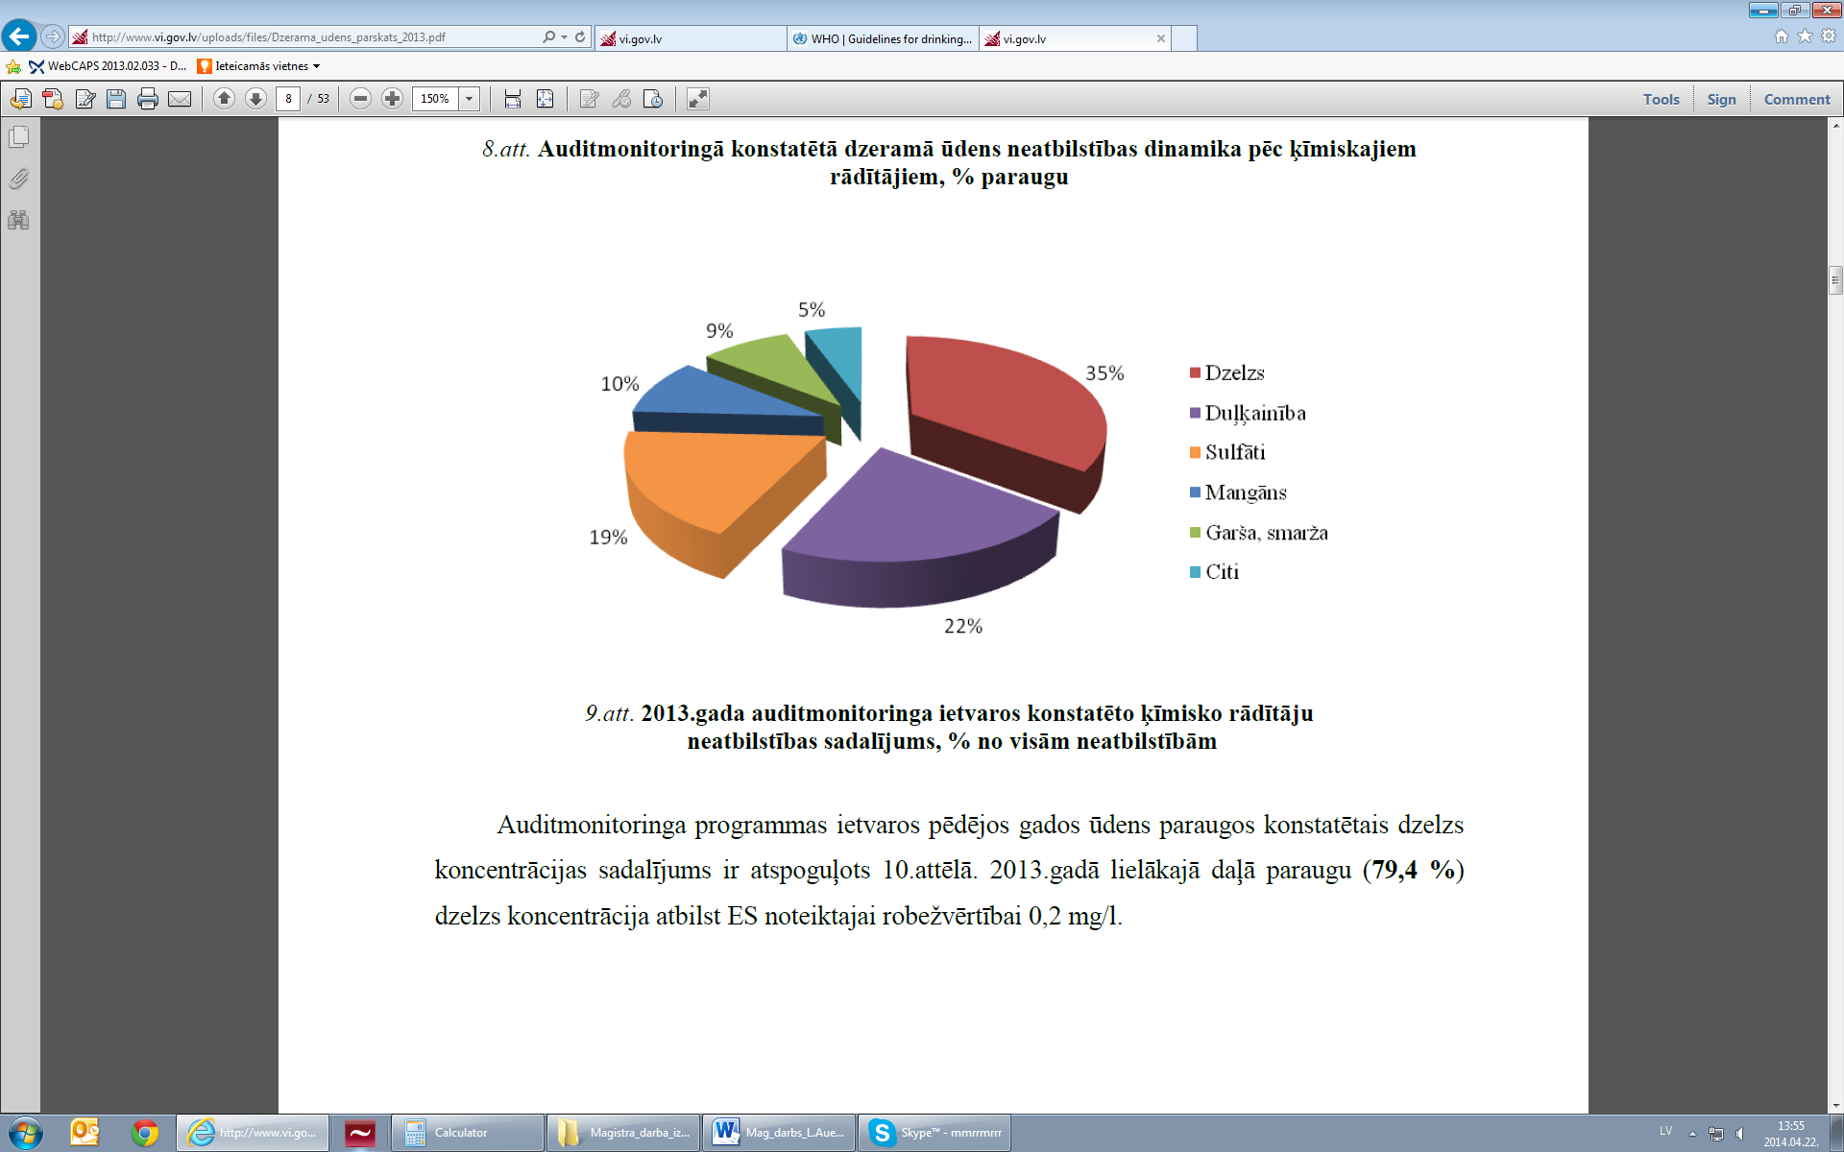
chemical parameters in 2013
Iron
Turbidity
Sulphates
Manganese
Taste, smell
Other
http://www.vi.gov.lv
Notes:
Veselības inspekcija, 2014
2013. gada ķīmisko rādītāju neatbilstības, rādītāju dinamika un dzelzs koncentrācija Latvijā

Slide 10
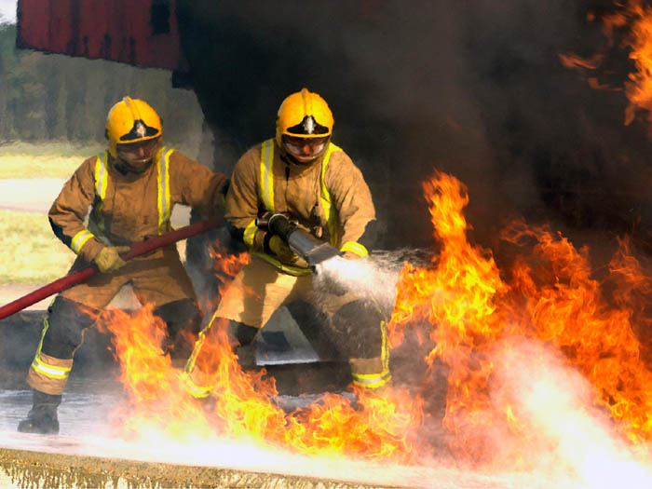
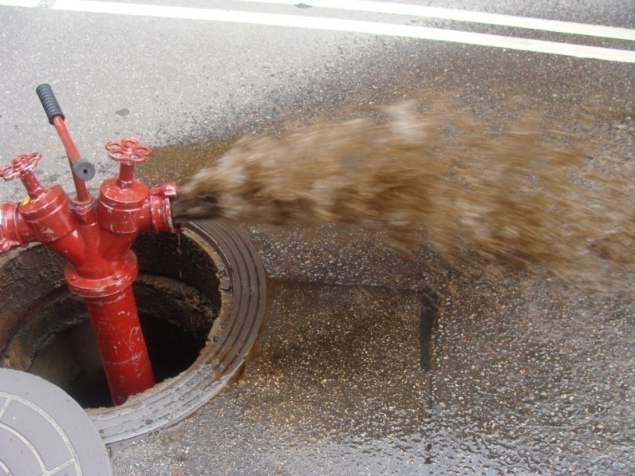
Cause
Notes:
10

Slide 11
Customers interviews
Attitudes Towards the Water Supplier
In order to increase the efficiency of the work, they think that water suppliers should change the old water pipes and to check the water quality on the regular basis.

Slide 12
Solution – unidirectional flushing

Slide 13
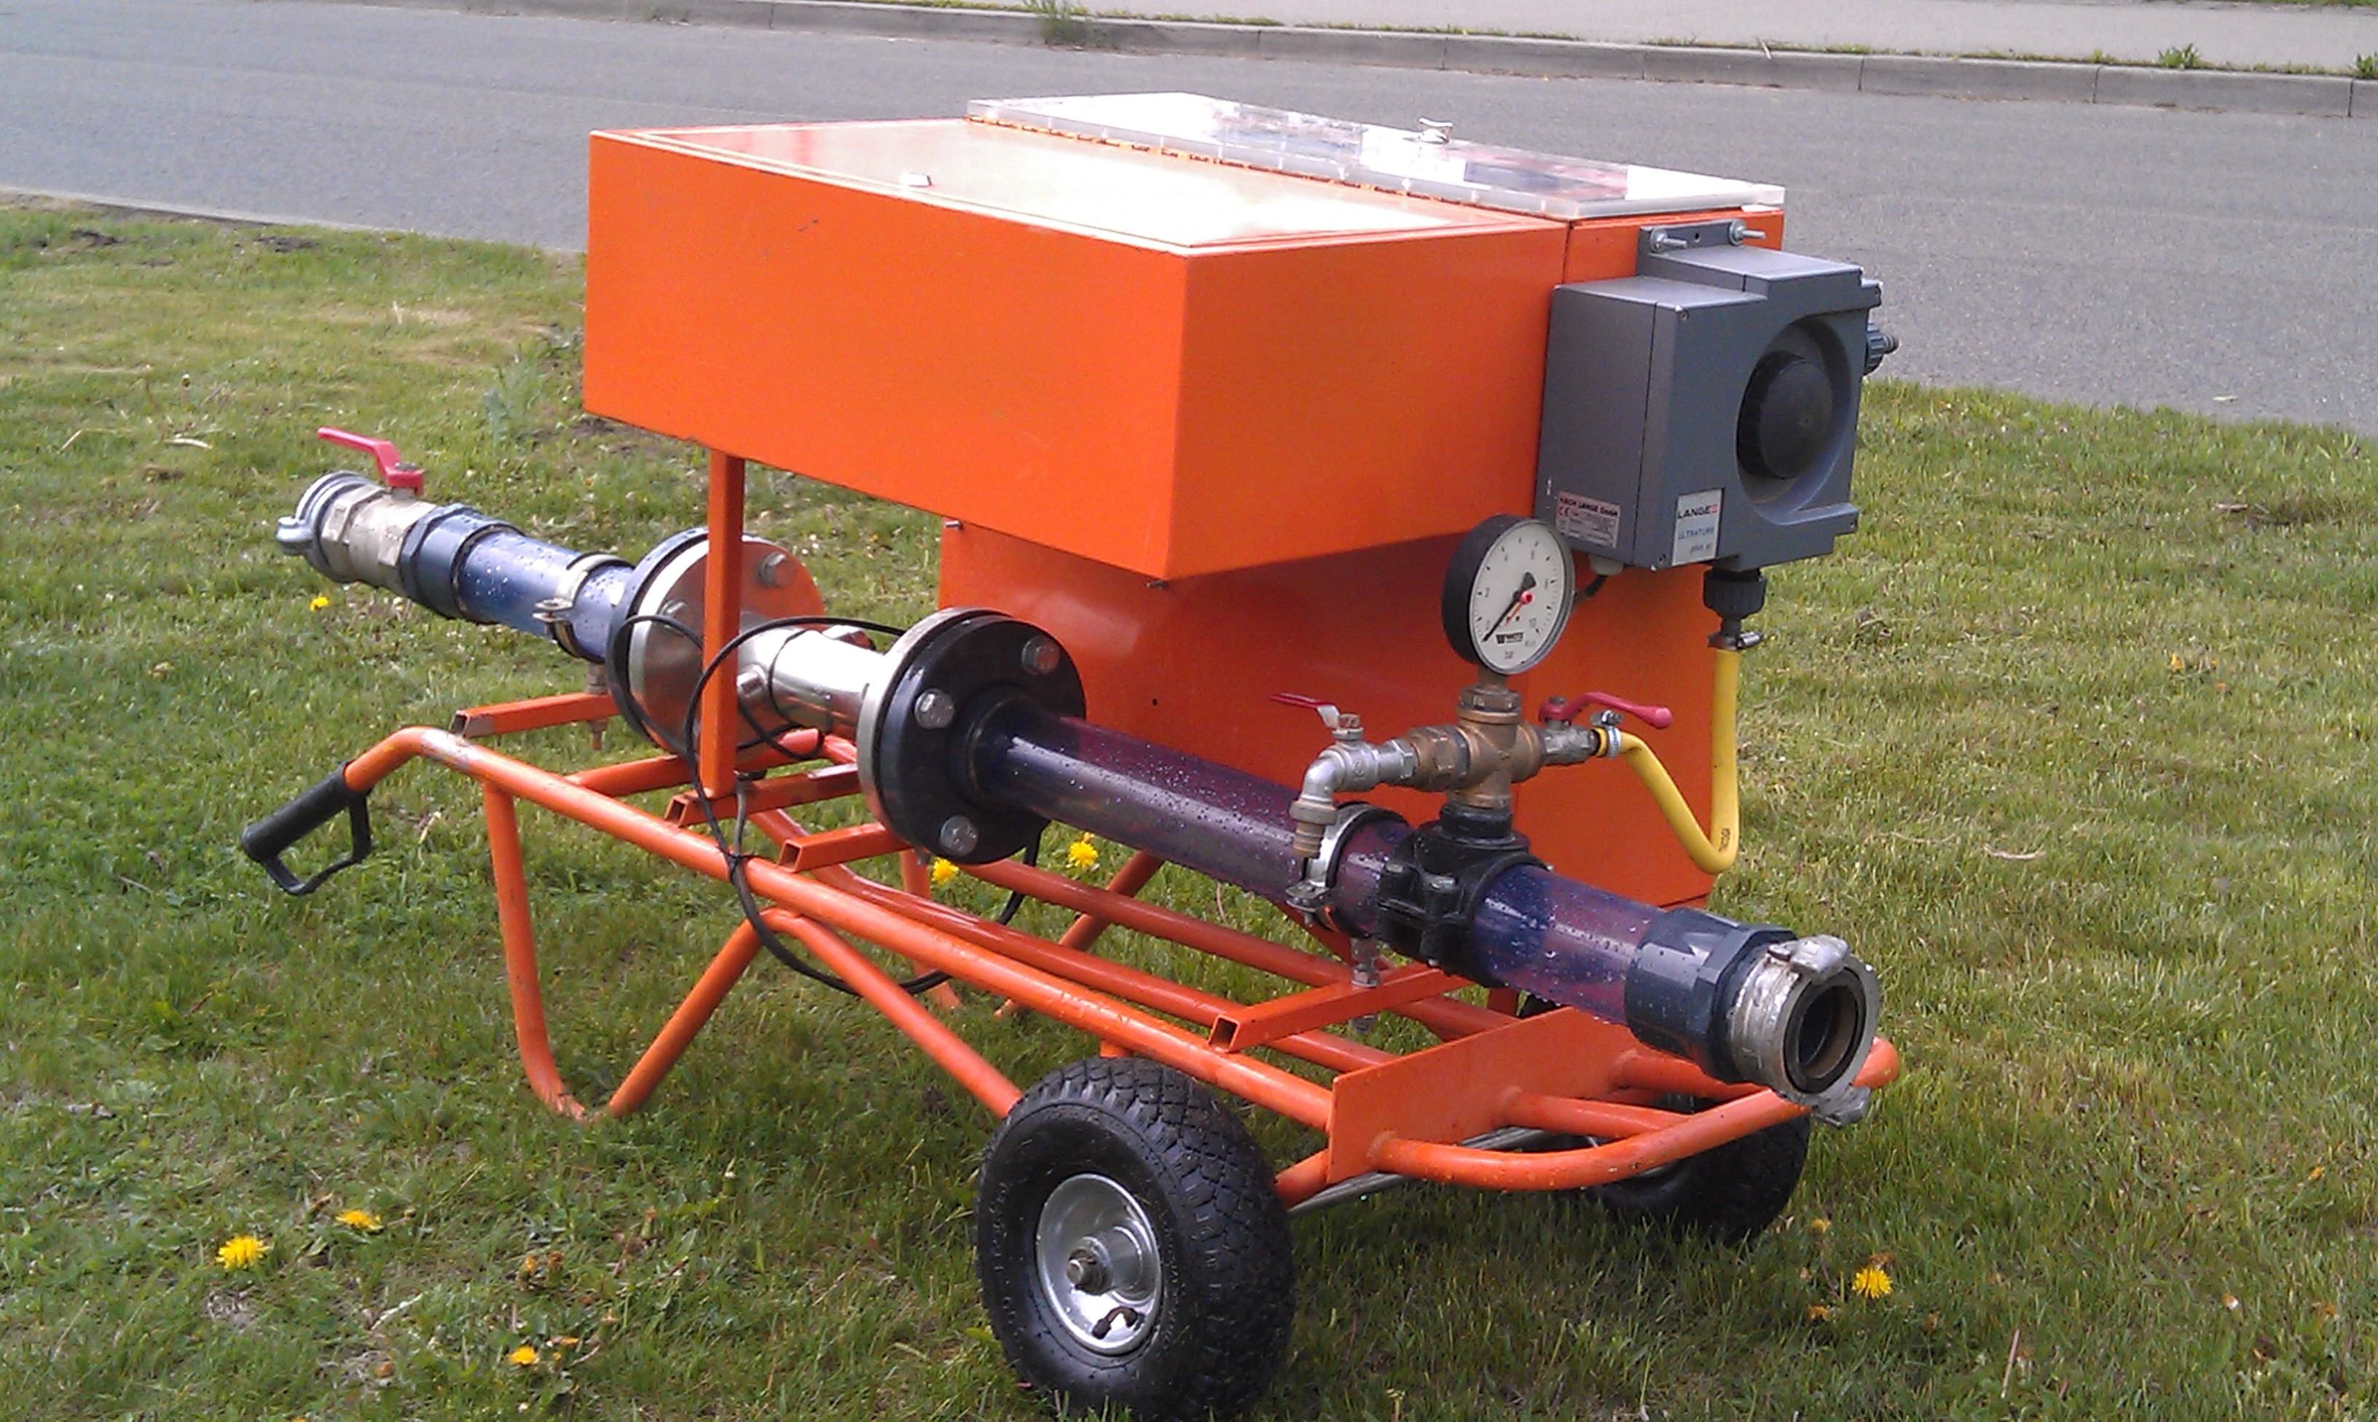

Procedure
Clean water front;
Minimal flow velocity 1.5 m/s;
Volume to be flushed: 2.
Notes:
Manipulējot ar aizbīdņiem un pakāpeniski skalojot ūdensvadu no attīrīšanas stacijas līdz tālākajam punktam
Minimālo ātrumu bieži arī nesanāca sasniegt, mazajiem diametriem galvenokārt spiediena zudumu dēļ, bet lielajiem diametriem arī iekārtu dēļ, kuras pievienotas ar 64mm neatļāva sasniegt lielāku caurplūdumu.
Centās skalot 2-3 caurules garumus (tilpumus), bet ja duļķainība bija augsta plūsmu nedaudz pakāpeniski piegriēza.

Slide 14
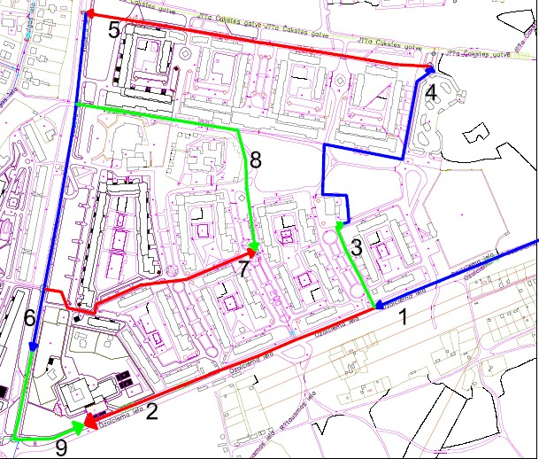
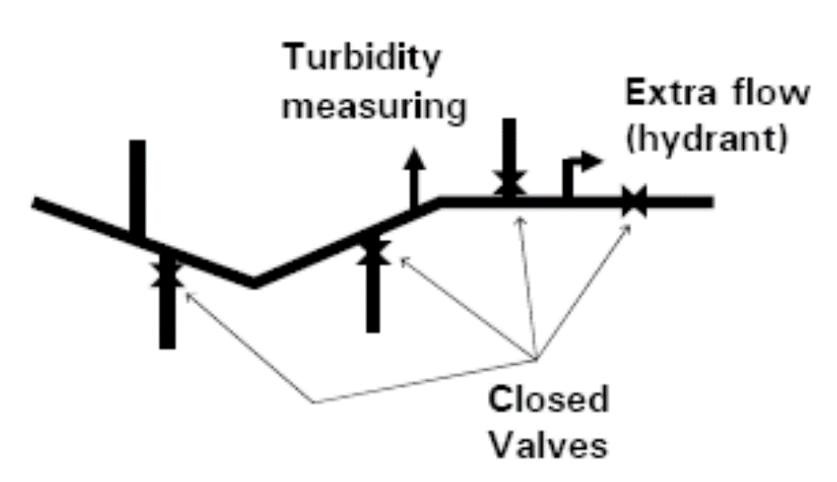
Procedure
Measurements:
Flow → velocity,
Turbidity
Notes:
14

Slide 15
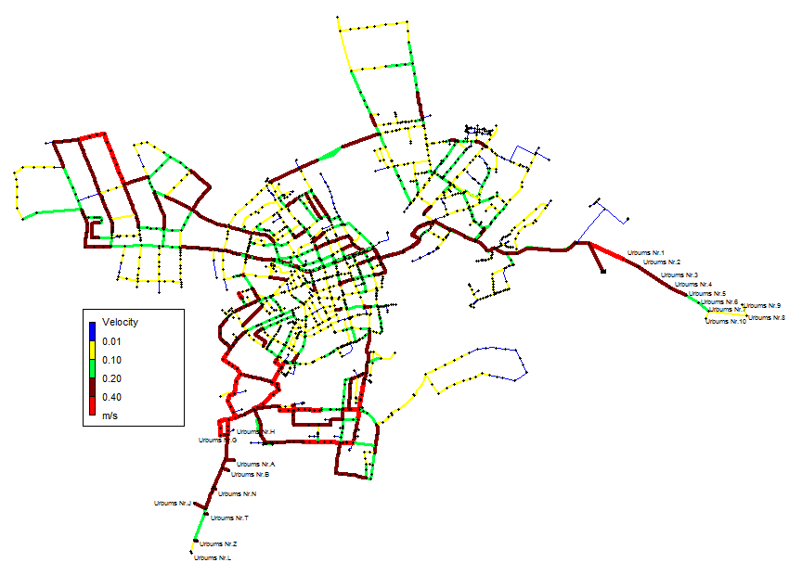
Hydraulic model is optional
Selfcleaning networks v>0,4m/s (Blokker et al 2010)
© J.H.G. Vreeburg
Notes:
15
The need for Hydraulic model is optional: Known velocities and critical locations

Slide 16
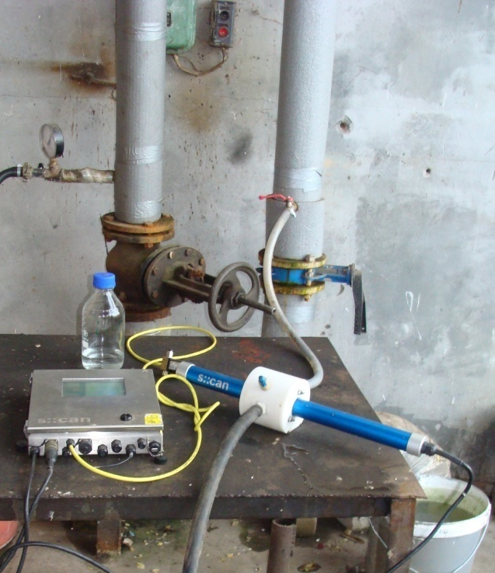
Turbidity monitoring at station
Notes:
16

Slide 17
experience

Slide 18
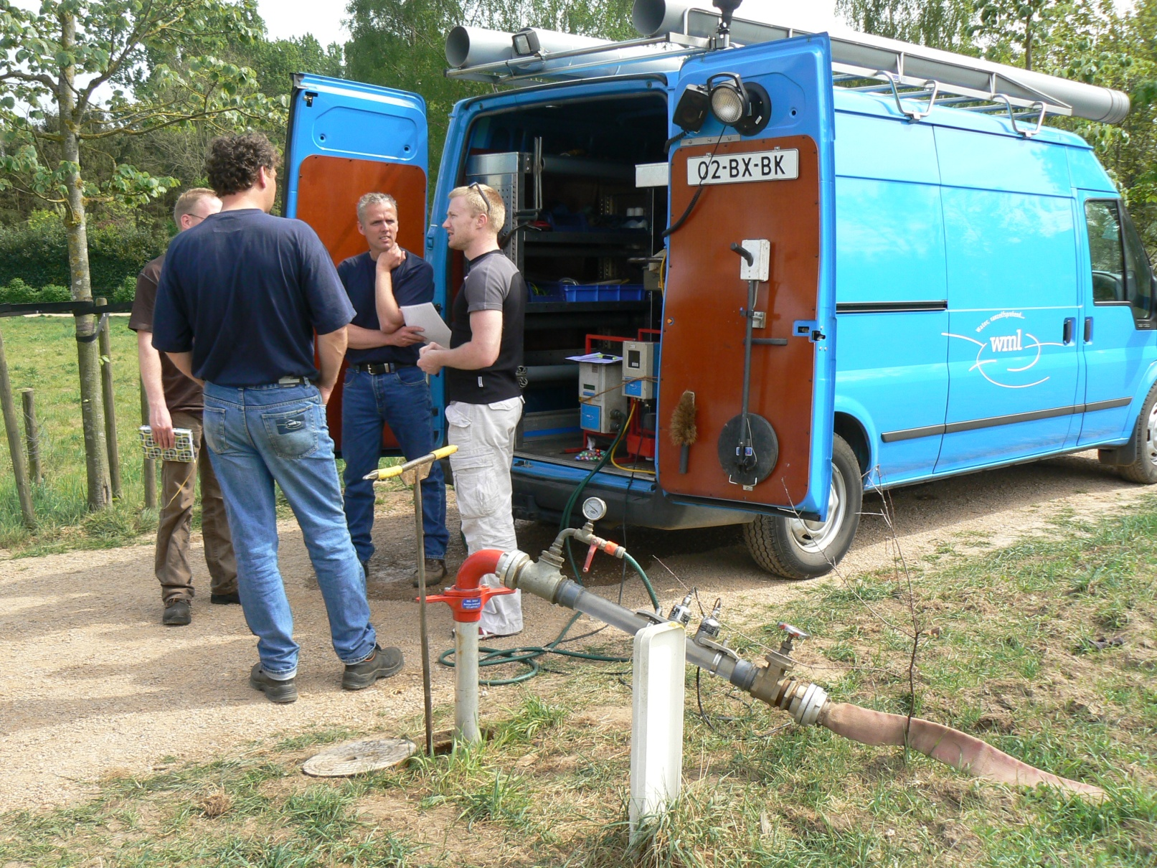
Netherlands (Watercycle Research Institute - KWR) and germany (Technologiezentrum Wasser - TZW)

Slide 19
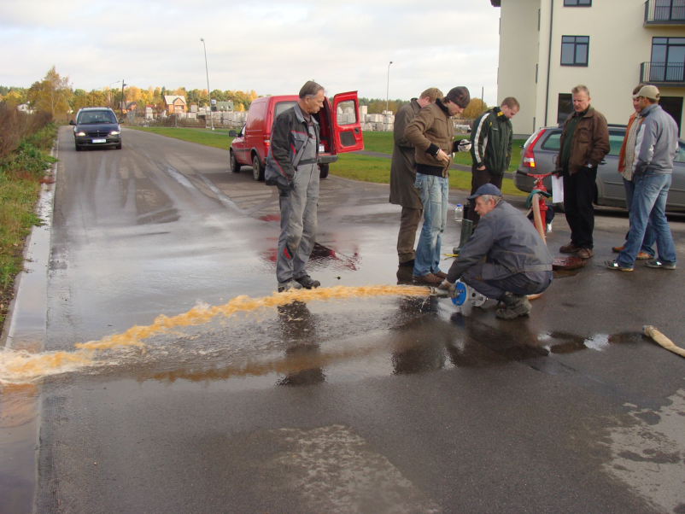
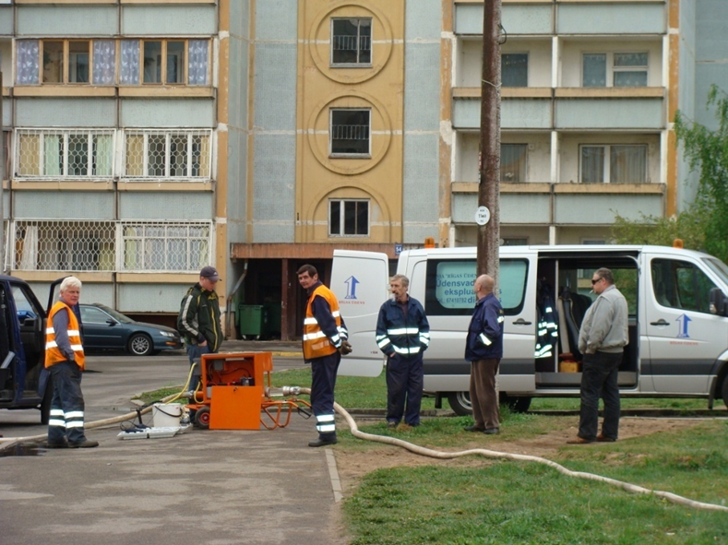
2008-2009
Rīga
Ādaži
Notes:
19

Slide 20
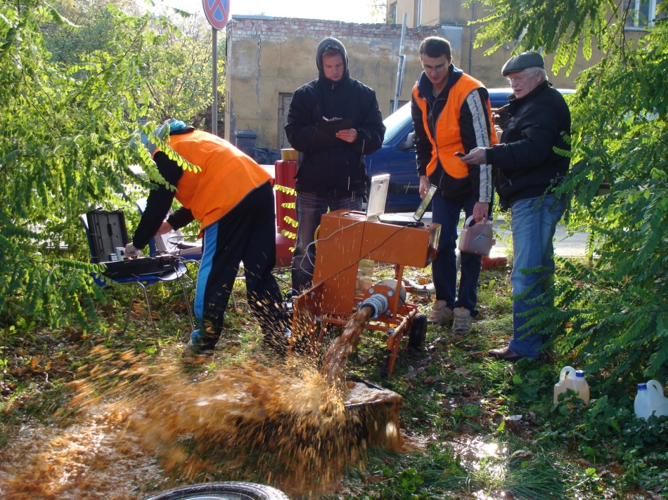
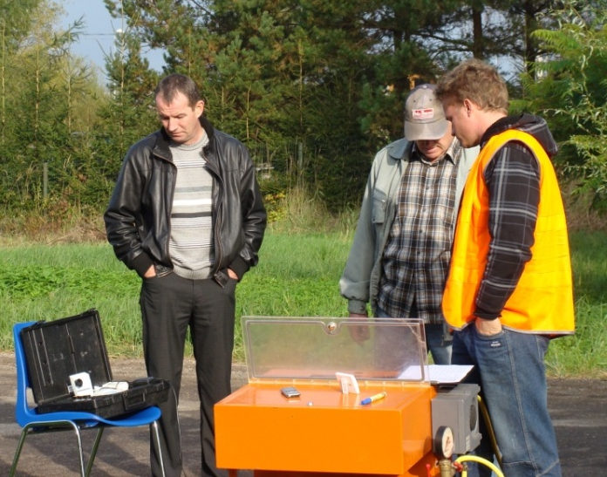
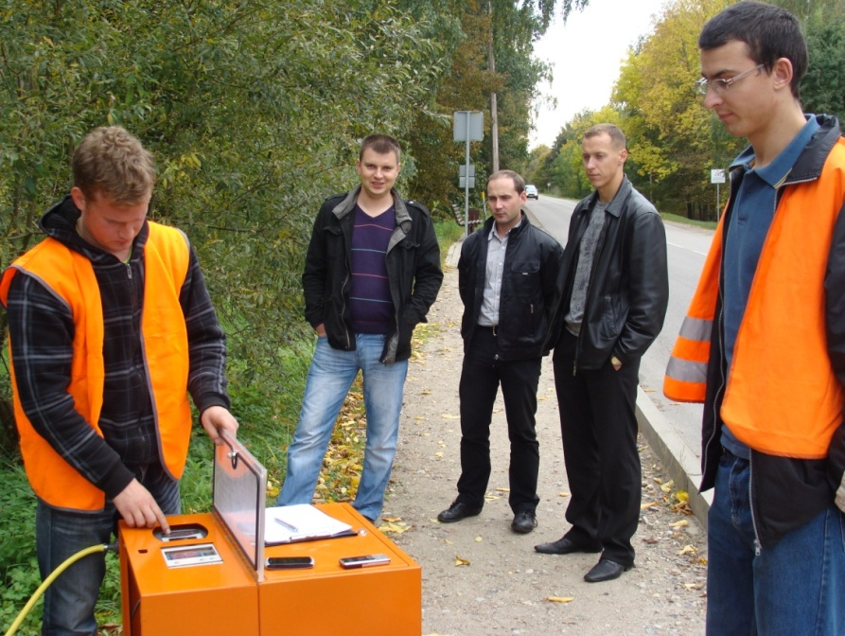
SIA Jelgavas water
Notes:
Tehniskais direktors Viktors Juhna, ūdens apgādes dienesta vadītājs Guntis Ābols, ražošanas tehniskās nodrošināšanas dienests Raimonds Mekša, Jānis Šeskens

Slide 21
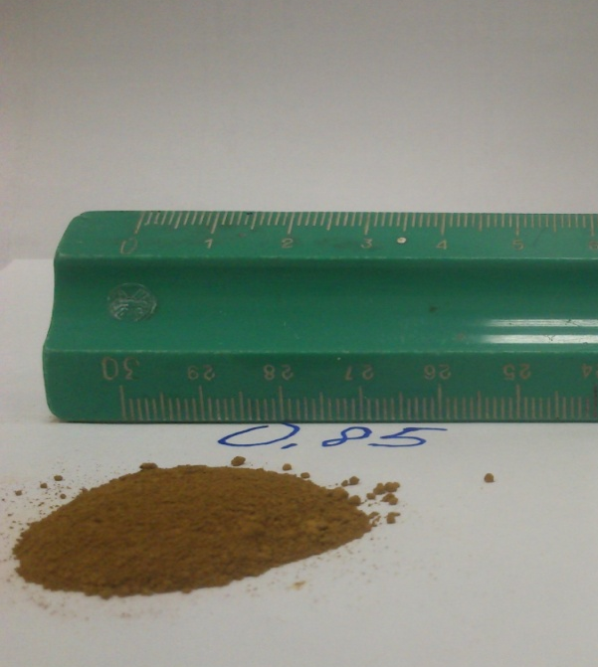
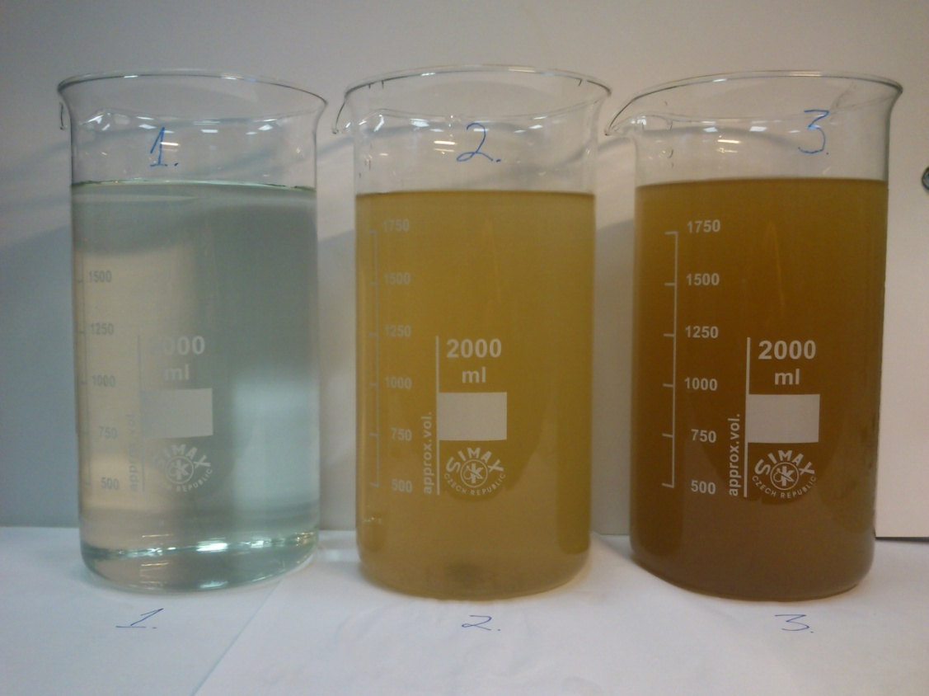
 | 2013 | 2014 | 2015
Flushed pipes, km | 84.2 | 85.2 | 79.05
Water for flushing, m3 | 8713.5 | 5337.4 | 3862.1
Time spent for flushing, h | 208 | 99 | 75
Flushed sediments (dry matter), kg | 286 | 273 | 120
Flushed sediments (dry matter), g/m | 3.4 (9.6) | 3.2 | 1.5
2015 vs 2013: 2x less water, 3x less time
2015: 2x more sediments in CI than PE
Notes:
Trials in a plastic only network with particle-free water produced by 0.1mm ultra-filtration demonstrated that particles responsible for discolouration can originate solely from the supplied water (Vreeburg et al., 2008).

Slide 22
Expected costs

Slide 23
Used water - 2 volumes from the pipe length (±10-15%).
Staff: 2
1 car
time: 4h for 1km
Amortization of instruments used for flushing

Slide 24
Customers interviews
Payment
Generally, consumers would wish to pay less for their water. The money paid for water is considered as corresponding to the water quality. The respondents would be ready to pay more for water, if the tap water would have excellent taste qualities.

Slide 25
Challenges and future trends
Water safety plan →Autumn 2017

Slide 26
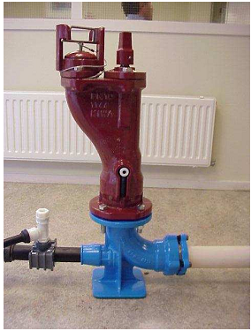
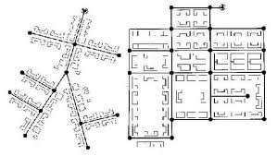
design principles in Latvia and the Netherlands
self-cleaning networks
 | Latvia | Netherlands
Water supply continuity | Depending on the population | Interruption is not allowed
Type of networks | looped/branched | branched
Minimum flow velocity | Not defined | 0,40 m/s
Minimum pressure at the consumer | 0,1 MPa | 0,2 MPa
Fire hydrant connection, capacity | Ø 110 mm | Ø 63 mm 30 m3/h instead of 90 m3
(Vreeburg et al 2009)
Notes:
Darbā tika analizēti projektēšanas principi Latvijā un Nīderlandē. Nīderlande praksē ir ieviesusi pašaatīrošo tīklu projektēšanu, kur minimāla spiediena, piegādes nepārtrauktības, ugunsdzēsības ūdens plūsmas prasībām un dzeramā ūdens kvalitātes prasībām pievienots vēl piektais kritērijs – ātruma, kritērijs, kurš nodrošina dzeramā ūdensapgādes tīklu pašattīrīšanos, līdz ar to izslēdzot mikroorganismu veidošanos.

Slide 27


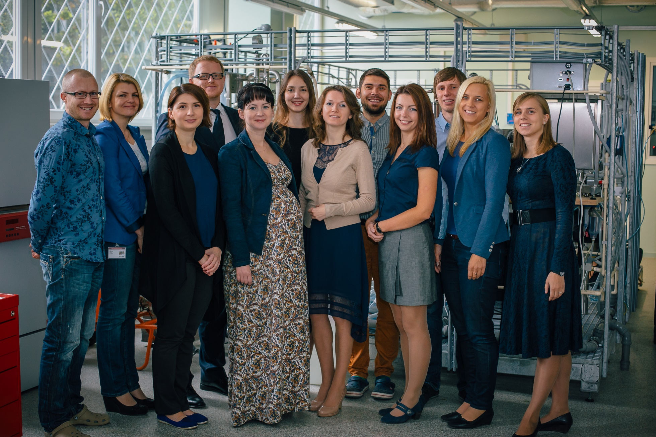
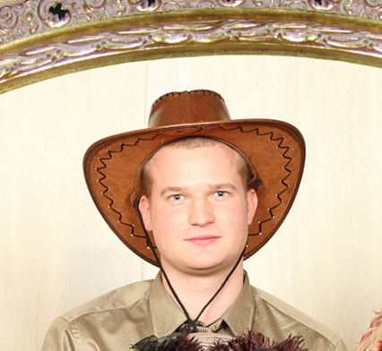
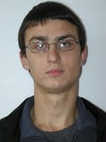

Acknowledgements
Kaspars Neilands, PhD student.
Ivars Šarenkovs, M.Sc.
Adazi udens Ltd., Jelgavas udens Ltd. and Rigas udens Ltd
www.wrl.bf.rtu.lv/en/
Notes:
27

Slide 28
Customers interviews
Bottled Water Consumption
consumed on a daily basis. In comparison to tap water, bottled water is considered to be cleaner, it does not have sediments and it is tastier. However, it is considered to be expensive.
Due to poor drinking water quality resulting from the pipe networks, it is assumed that consumers do not trust their tap water quality, often leading them to purchase bottled water.

Slide 29
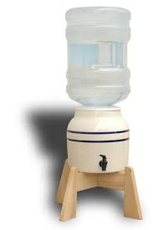
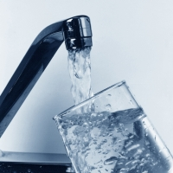
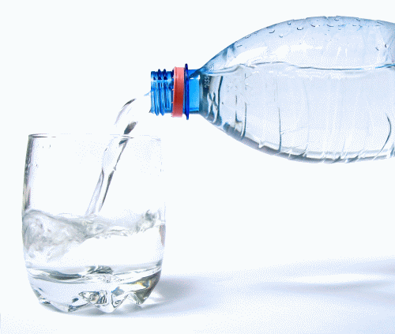
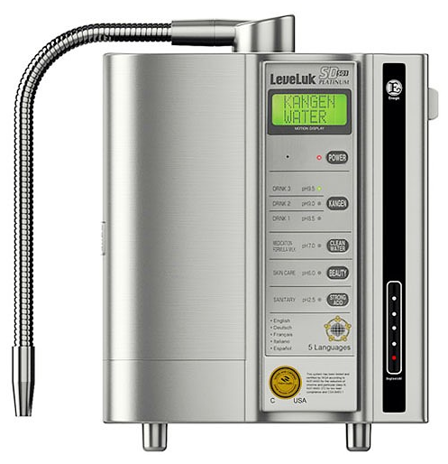
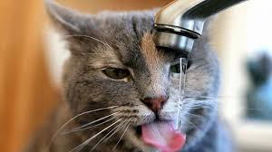
Notes:
take-home message
it is assumed that consumers do not trust their tap water quality, often leading them to purchase bottled water.
consumed on a daily basis. In comparison to tap water, bottled water is considered to be cleaner, it does not have sediments and it is tastier. However, it is considered to be expensive.

Slide 30
Drinking water network flushing: tool to save water quality
BALTIC WATER WORKS CONFERENCE 2016
Thank you!
Dr.Sc.ing., assoc.proff. Jānis Rubulis
Riga Technical university
www.wrl.bf.rtu.lv/en/
janis.rubulis@rtu.lv
mob.phone.+37129438018
Tallink M/S Victoria I
19.05.2016

Slide 31
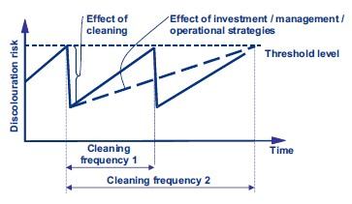
MOTIVĀCIJA

Slide 32
Flushed sediments (dry matter), g/m
0.003-0.052 – Australia (Rayan et al 2008)
0.027-0.23 – Netherlands (with ultrafiltratition) (Vreeburg et al 2008)
0.26 - 0.4 – Canada (Barebout-Benoit et al 2005)
0.053-3.1 – Netherlands (Vreeburg et al 2008)
1.5 - 3 (9.6) – Jelgava (2013-2015)
Up to 12 – France (Harmant et al.2000)
0.3 – 24 – Canada (Carriere et al. 2005)
0.08 - 50 – USA (Delanoue et al, 1997)
Notes:
The concentration of particles in Latvian DWN is higher compared to others countries (Canada, Netherlands, UK)

Slide 33
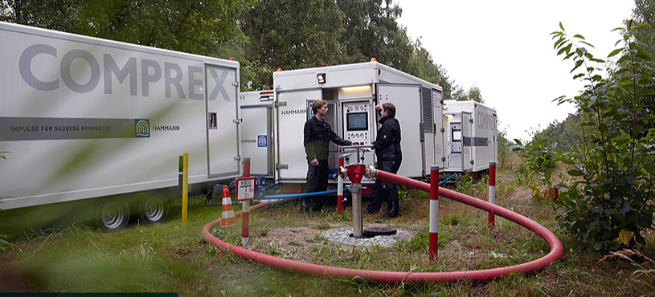
> DN 250
^{www.hammann-gmbh.de}

Slide 34
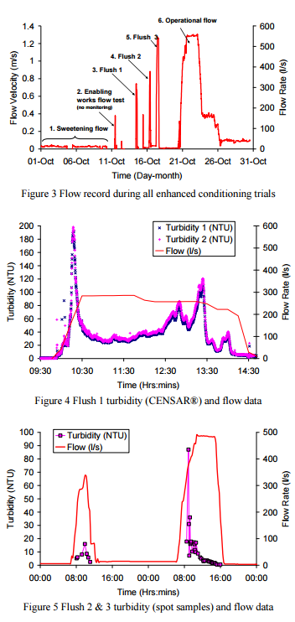
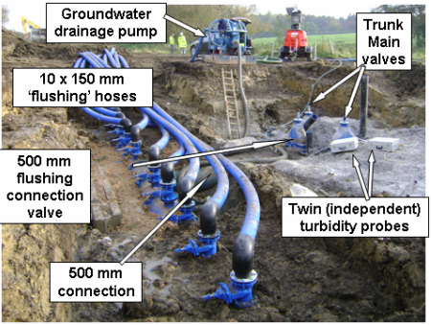
Husband et al 2011, UK
500 l/s (1.35 m/s)
Severn Trent Water
Notes:
13.3 km long 700 mm (27”) diameter lined steel trunk main had been run with only a sweetening ‘trickle’ flow of around 15 l/s or 0.04 m/s. Due to the volumes of water required during flushing and the likelihood of significant material being mobilised, discharge was planned into storm tanks at a waste water treatment plant adjacent to the trunk main at 10 km along its length. To facilitate this a temporary 500 mm connection was fitted and this was linked to ten 150 mm ‘flushing hoses’, Figure.

Slide 35
Daļiņu raksturojums
Kvarcs SiO2
Getīts FeO(OH)
Alunīts AlSO4·H2O
Laboratoriski analizēts daļiņu ķīmiskais sastāvs kopumā no 24 paraugiem
Kvarcs SiO2
Getīts FeO(OH)
Getīts FeO(OH)
Izskaloto daļiņu vidējie diametri ir robežās no <1 μm līdz 619 μm (n=28).
Notes:
35

Slide 36
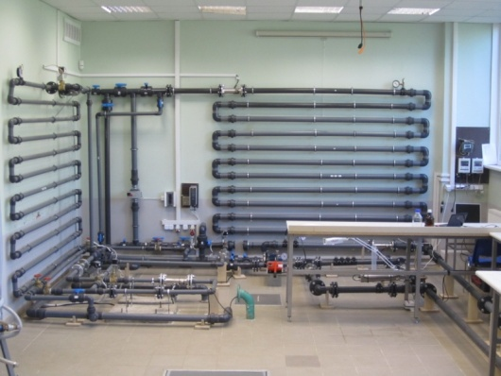
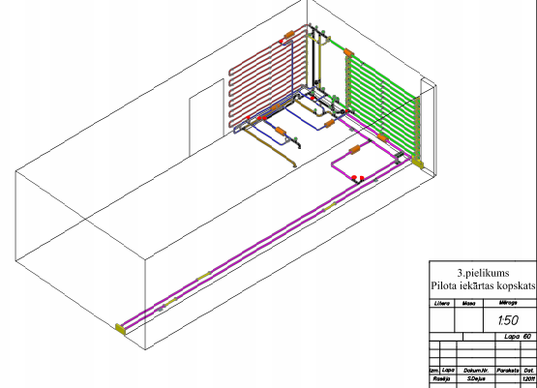
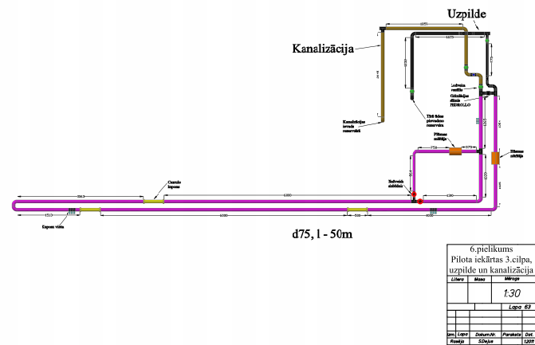

Slide 37
Experience in Latvia
AR – mākslīgi papildināts pazemes ūdens, CI – kaļamais ķets, G – pazemes ^{ūdens, PE - polietilēns,}
PVC - polivinilhlorīds, S – virszemes ūdens, UI - tērauds, WTP- ūdens attīrīšanas stacija

Slide 38
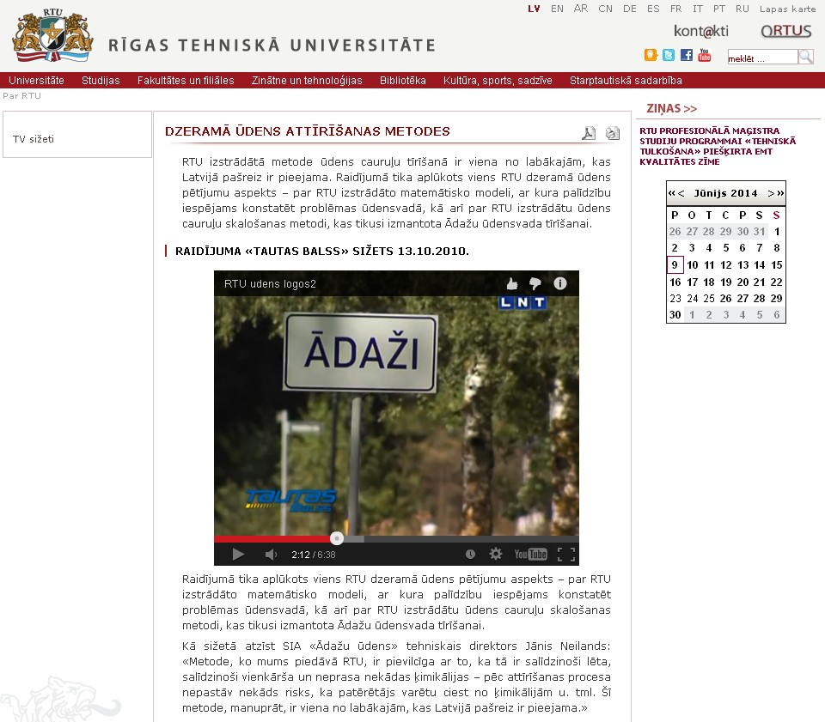
http://www.rtu.lv/content/view/5047/1837/lang,lv/

Slide 39
Notes:
Consumption trends

Slide 40
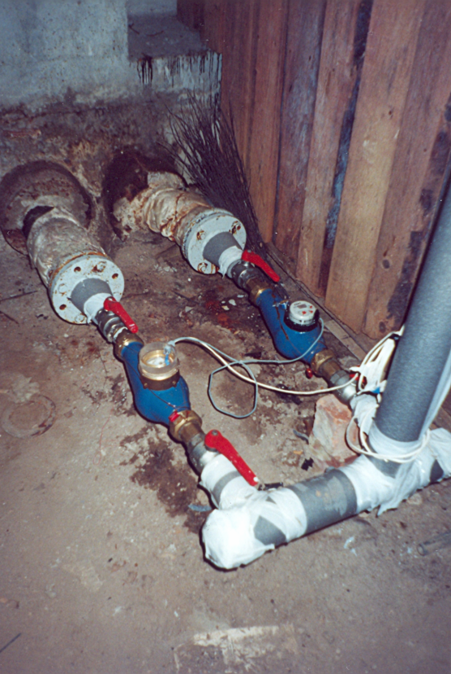
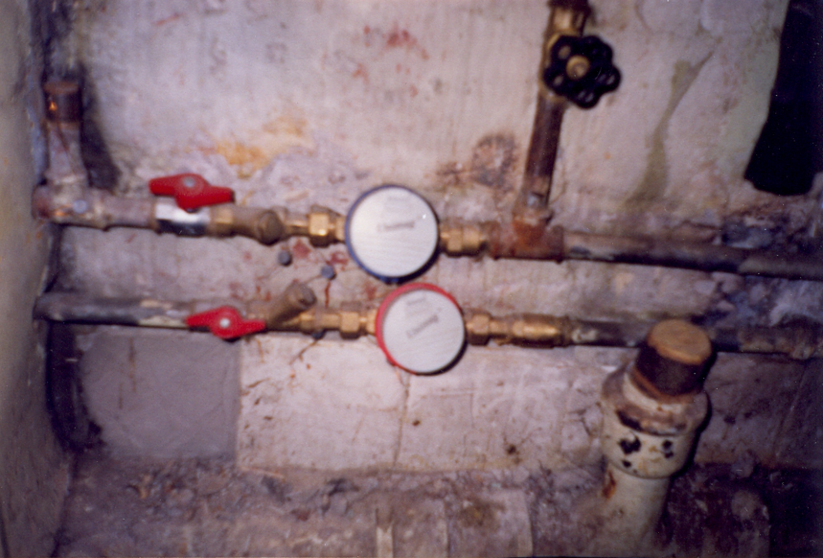
Drinking water counting
Rubulis (2002)

